Slide 1
The RealReal -- Copywriting
As a Senior Copywriter, I conducted careful research to include artistic and cultural references, product category terminology, brand history and heritage, runway looks, notable creative directors, and pop culture. I gained experience in both technical copywriting (fashion) and creative copywriting (books). Below are some examples of my copy, both as it appeared on the website and demarcated in black boxes, and color-coded annotations of the significance behind it.
Women’s Handbags
Women’s RTW
Menswear
Books – Fashion and Art

Slide 2
Women’s Handbags

Slide 3
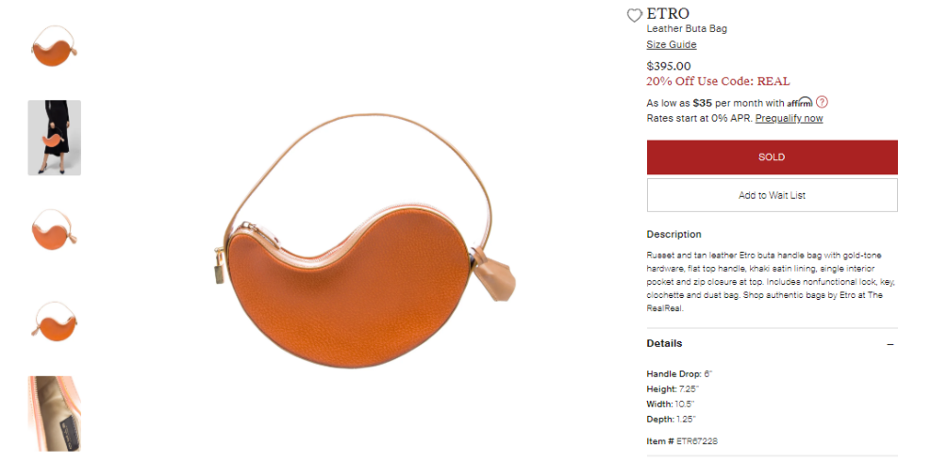
Culture – the buta or boteh (بته‎), “bush” in Farsi, a Zoroastrian symbol of life and eternity originating in Sassanid Iran as early as the third century, is the curved teardrop shape serving as the foundation of the paisley pattern, which dates back to sixteenth-century Kashmir. Paisley is also a brand signature for Etro, and the use of a standalone buta shape for a novelty bag communicates the brand’s identity.
Interior features are the most crucial to product copy because they are not apparent in the photography.
Etro Leather Buta Bag
Russet and tan leather Etro buta handle bag with gold-tone hardware, flat top handle, khaki satin lining, single interior pocket and zip closure at top. Includes nonfunctional lock, key, clochette and dust bag. Shop authentic bags by Etro at The RealReal.
Special collateral enhances value and convenience.
Customer transparency -- this lock is purely aesthetic.
Terminology – “bell” in French, a clochette is a storage unit especially for the key to a handbag.
SEO meta description

Slide 4
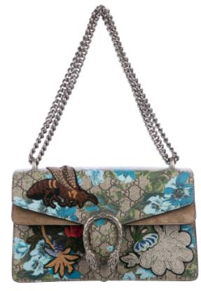
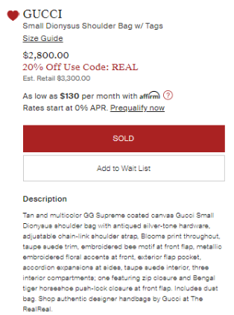
Brand signature – GG Supreme is the Gucci brand’s official term for its rhomboid monogram logo pattern when applied to coated canvas.
GUC281743
Material -- coated canvas is cotton canvas coated with polyvinyl chloride (PVC), creating a smoother texture and slightly glossier appearance.
Size – a smaller size means a lower price but less storage.
Style name – components of brand identity, style names are SEO aids that enhance searchability on a site with millions of products for sale at any given time. Dionysus or Dionysos (Διόνυσος ) was the ancient Greek god of the grape harvest, wine, ritual madness and religious ecstasy.
Terminology – an antique finish is a process applied to metal or wood to give it a distressed, aged look, that can be achieved by rubbing the surface with sandpaper or steel wool.
Special functions and collateral enhance value and convenience.
Brand signature – an update to the signature Flora pattern, Blooms is a floral pattern designed by creative director Alessandro Michele.
Gucci Small Dionysus Shoulder Bag w/Tags
Tan and multicolor GG Supreme coated canvas Gucci Small Dionysus shoulder bag with antiqued silver-tone hardware, adjustable chain-link shoulder strap, Blooms pattern throughout, taupe suede trim, embroidered bee motif at front flap, metallic embroidered floral accents at front, exterior flap pocket, accordion expansions at sides, taupe suede interior, three interior compartments; one featuring zip closure and Bengal tiger horseshoe push-lock closure at front flap. Includes dust bag. Shop authentic designer handbags by Gucci at The RealReal.
Brand signatures – the bee and Bengal tiger are recurring motifs from recent collections.
Terminology – accordion expansions are a stylish way to add storage space.
Interior features are the most crucial to product copy because they are not apparent in the photography.
Culture -- dating back to 400 BC Etruria, horseshoe motifs today conjure images of the nineteenth-century American West.
SEO meta description

Slide 5
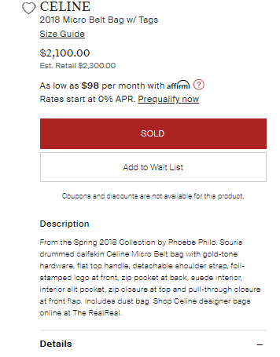
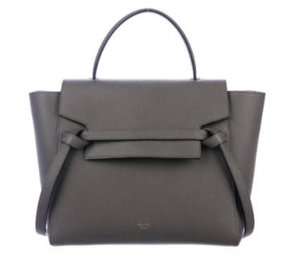
Recency (especially within the past 3 years) adds value to pre-owned products. Citing the seasonal collection places the item within the context of that collection’s themes and inspirations and the overall brand history.
Interior features are the most crucial to product copy because they are not apparent in the photography.
CEL84210
Creative director -- Phoebe Philo (2008-2018) was an especially notable creative director of Celine, creating a minimalist, angular image of power for female professionals, bolstered by practical details for convenience. Her designs spiked in value on the resale market following her departure from the brand.
Brand signature – color specific to Celine. “Mouse” in French.
Terminology – drumming means the leather is tumbled in a rotating drum while dyed for richer color immersion.
Material – calfskin is scarcer (smaller pelts), and therefore more valuable, than cowhide. Its combination of softness and durability makes it ideal for handbags.
SEO meta description
Celine 2018 Micro Belt Bag From the Spring 2018 Collection by Phoebe Philo. Souris drummed calfskin Celine Micro Belt bag with gold-tone hardware, flat top handle, detachable shoulder strap, foil-stamped logo at front, zip pocket at back, suede interior, interior slit pocket, zip closure at top and pull-through closure at front flap. Includes dust bag. Shop Celine designer bags online at The RealReal.
Size – a smaller size means a lower price but less storage. “Micro” is a brand signature term.
Style name – components of brand identity, style names are SEO aids that enhance searchability on a site with millions of products for sale at any given time.
Special functions and collateral enhance value and convenience.
The logo is the greatest value driver for handbags.

Slide 6
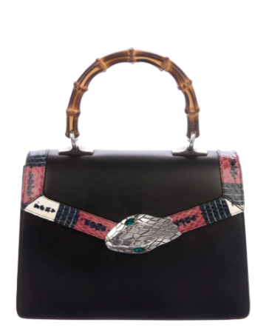
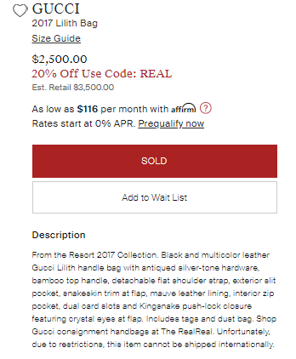
Recency (especially within the past 3 years) adds value to pre-owned products. Citing the seasonal collection places the item within the context of that collection’s themes and inspirations and the overall brand history.
GUC282501
Style name – components of brand identity, style names are SEO aids that enhance searchability on a site with millions of products for sale at any given time.
Terminology – an antique finish is a process applied to metal or wood to give it a distressed, aged look, that can be achieved by rubbing the surface with sandpaper or steel wool.
Brand signature – whether used as a handbag handle, a small adornment, or a repeated motif in a print, bamboo communicates the Gucci brand identity.
Special functions and collateral enhance value and convenience.
Materials – snakeskin is harder to obtain, and therefore more valuable, than the leather of traditional farm animals like cows, sheep, goats and pigs.
Gucci 2017 Lilith Bag
From the Resort 2017 Collection. Black and multicolor leather Gucci Lilith handle bag with antiqued silver-tone hardware, bamboo top handle, detachable flat shoulder strap, exterior slit pocket, snakeskin trim at front flap, mauve leather lining, interior zip pocket, dual card slots and Kingsnake push-lock closure featuring crystal eyes at flap. Includes tags and dust bag. Shop Gucci consignment handbags at The RealReal.
Interior features are the most crucial to product copy because they are not apparent in the photography.
Brand signature – with a natural habitat ranging from southern Canada to southern Ecuador, the kingsnake is a recurring motif from recent collections.
Eyes – transcends the language of product specs to animate the character of the kingsnake.
SEO meta description

Slide 7
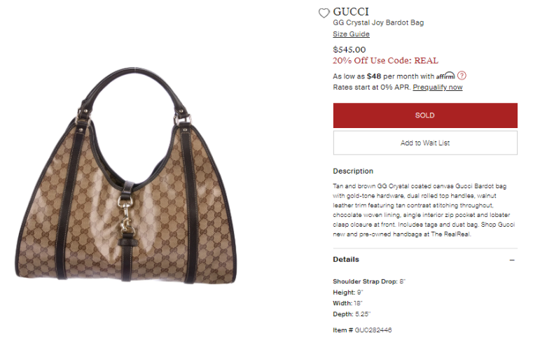
Brand signature – GG Crystal is the Gucci brand’s official term for its rhomboid monogram logo pattern when applied to coated canvas with a patent sheen.
Material -- coated canvas is cotton canvas coated with polyvinyl chloride (PVC), creating a smoother texture and slightly glossier appearance.
Style name –components of brand identity, style names are SEO aids that enhance searchability on a site with millions of products for sale at any given time. Named for French actress and singer Brigitte Bardot.
Interior features are the most crucial to product copy because they are not apparent in the photography.
Terminology – resembling a lobster claw, a lobster clasp closure is opened by pushing a lever downward and closed by releasing it.
Gucci GG Crystal Bardot Bag
Tan and brown GG Crystal coated canvas Gucci Bardot bag with gold-tone hardware, dual rolled top handles, walnut leather trim featuring tan contrast stitching throughout, chocolate woven lining, single interior pocket and lobster clasp closure at front. Includes tags and dust bag. Shop Gucci new and pre-owned handbags at The RealReal.
Special collateral enhances value and convenience.
SEO meta description

Slide 8
Women’s RTW

Slide 9
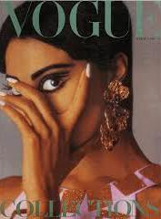
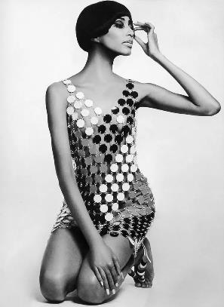
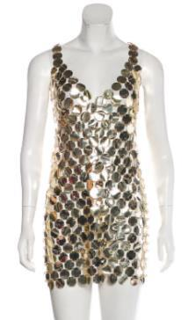
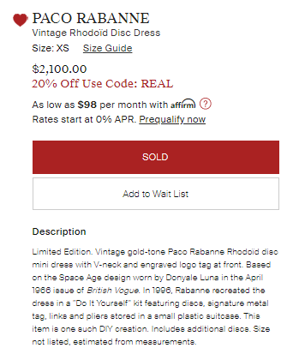
WPC20722
Era – in addition to being scarce, vintage pieces provide a window into the past, and their aesthetic conspicuousness is magnified by the distance between their time and ours.
Culture -- the Space Age of the late 1950s and 1960s, inspired by the launch of Sputnik 1, Neil Armstrong and Edwin “Buzz” Aldrin’s moon landing, and the Space Race between the United States and the Soviet Union, affected the fashion world as well, especially Paco Rabanne, Courrèges and Pierre Cardin.
Material – Rhodoïd, derived from cellulose, is a malleable plastic commonly used in buttons and eyewear frames, mutable enough to adopt the luster, texture and toughness of metal.
Celebrity – Model and actress Peggy Freeman, or Donyale Luna, was the first African-American model to appear on the cover of British Vogue.
Paco Rabanne Vintage Rhodoïd Disc Dress
Limited Edition. Vintage gold-tone Paco Rabanne Rhodoïd disc mini dress with V-neck and engraved logo tag at front. Based on the Space Age design worn by Donyale Luna in the April 1966 issue of British Vogue. In 1996, Rabanne recreated the dress in a "Do It Yourself" kit featuring discs, signature metal tag, links and pliers stored in a small plastic suitcase. This item is one such DIY creation. Includes additional discs.
Editorial coverage – few fashion products make it to high-profile magazines, and the items’ increased visibility means greater recognition for those who wear them.

Slide 10
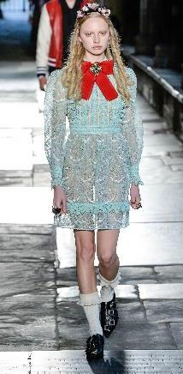
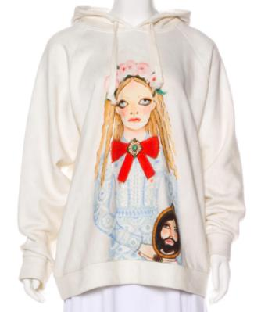
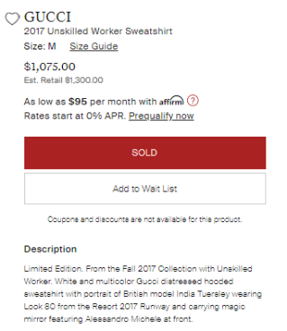
British painter Helen Downie, or Unskilled Worker, is known for her flat chalk portraiture of characters with large eyes and heart-shaped faces. Inspired by picture books, the sense of wonder she felt as a child, and “the expression on people’s faces when they don’t think anyone is looking” (Dresden 2017), Downie has worked with Gucci and Alexander McQueen.
GUC243105
Recency (especially within the past 3 years) adds value to pre-owned products. Citing the seasonal collection places the item within the context of the overall brand history.
Culture – magic mirrors are a literary trope, playing pivotal roles in stories like “Snow White”, Through the Looking-Glass, and The Picture of Dorian Gray.
Gucci 2017 Unskilled Worker Sweatshirt
Limited Edition. From the Fall 2017 Collection with Unskilled Worker. White and multicolor Gucci distressed hooded sweatshirt with portrait of British model India Tuersley wearing Look 80 from the Resort 2017 Runway and carrying magic mirror featuring Alessandro Michele at front.
Limited Edition -- scarcity increases the item’s value.
Inspiration -- Alessandro Michele’s maximalist designs and outlandish styling, of Victorian influence yet madcap to some point ahead of our time, fit seamlessly within Unskilled Worker’s fantastical parallel to our world. Tracking down the runway looks and affixing each piece to a moment in Gucci’s past tells the TRR customer a deeper story beyond the novelty of a limited-edition capsule collection.
Creative director – Alessandro Michele (2015-present) transformed the Gucci brand and brought it to the forefront of pop culture (and sales) with his sensory overload of discordant inspirations, vivacious animal characters, and visionary androgyny of styling male models in feminine outfits.

Slide 11
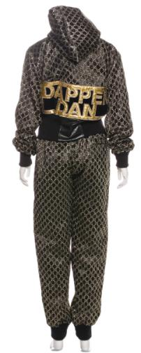
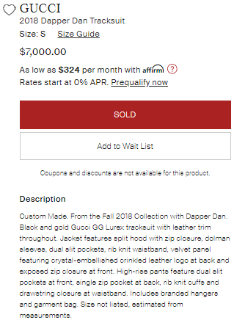
African-American fashion designer Daniel Day, or Dapper Dan, started his Harlem boutique in 1983 with the intention of becoming a wholesaler, but was obstructed due to widespread racial prejudice from textile companies, who refused to sell him the fabrics and materials he needed. Day then resolved to make his own products from scratch. He purchased machinery from American garment factories that were shut down as brands started to outsource manufacturing to China and invented a technique for embossing large logos onto the heaviest materials, like leathers and furs. He crafted made-to-measure items for his customers, with entirely original shapes, emblazoned with the logos of high-profile luxury brands (including Gucci) in luxurious protest of the mainstream fashion industry’s disdain for and exclusion of black people. In 1992, Fendi sued him for counterfeiting and his brand went bankrupt. Then in the early 2000s, he saw his designs copied by European luxury brands. But in 2017, Gucci reached out to Day for a collaboration, as an homage to his resourcefulness and creativity at a time when his community was shunned by the luxury fashion industry, and as an act of apology for Gucci’s history of racism and cultural appropriation. This gesture to give Day the credit he
GUC273855
was due resulted in highly sought-after Dapper Dan creations as fabulous as old times.
Gucci 2018 Dapper Dan Tracksuit
Custom Made. From the Fall 2018 Collection with Dapper Dan. Black and gold Gucci GG Lurex tracksuit with leather trim throughout. Jacket features split hood with zip closure, dolman sleeves, dual slit pockets, rib knit waistband, velvet panel featuring crystal-embellished crinkled leather logo at back and exposed zip closure at front. High-rise pants feature dual slit pockets at front, single zip pocket at back, rib knit cuffs and drawstring closure at waistband. Includes branded hangers and garment bag.
Terminology – a split hood zips down the middle for versatility.
Special collateral enhances value and convenience.

Slide 12
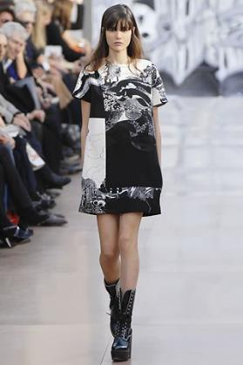
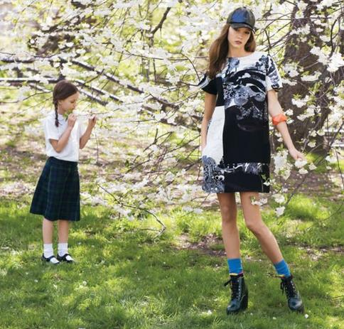
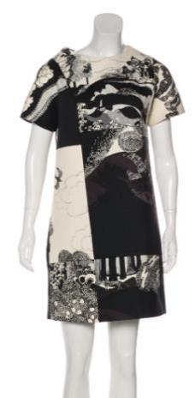
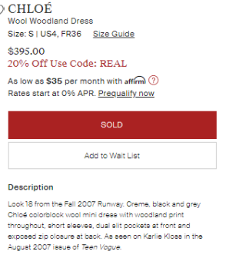
CHL83624
CHL83624
Chloé Wool Woodland Dress
Look 18 from the Fall 2007 Runway. Creme, black and grey Chloé colorblock wool mini dress with woodland print throughout, short sleeves, dual slit pockets at front and exposed zip closure at back. As seen on Karlie Kloss in the August 2007 issue of Teen Vogue.
Citing the seasonal collection places the item within the context of that collection’s themes and the overall brand history. Runway items are selected to showcase the season’s offering at its most eyecatching, innovative and symbolic.
Celebrity -- American model and Project Runway co-host Karlie Kloss is one of the top supermodels to emerge in the twenty-first century, with 16.6 million followers across social media and even more fans. This photo shoot, taken when Kloss was fourteen, is historic as her first editorial work.
Editorial coverage – even fewer fashion products make it to high-profile magazines than the runway, and the items’ increased visibility means greater recognition for those who wear them. In the case of a 2007 issue, there is also a sense of nostalgia.

Slide 13
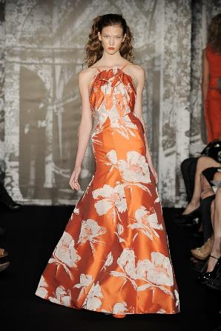
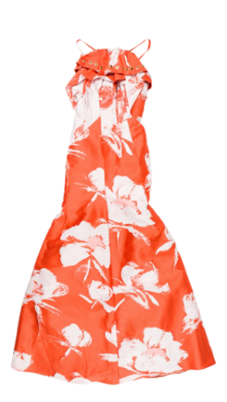
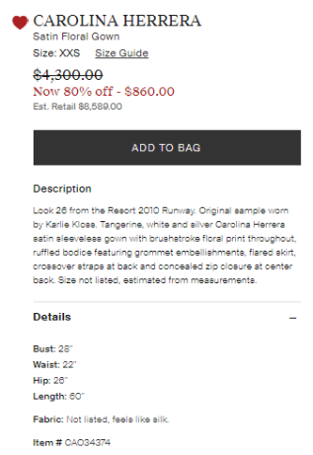
Citing the seasonal collection places the item within the context of that collection’s themes and inspirations and the overall brand history. Runway items are selected by the creative director to showcase the season’s offering at its most eyecatching, innovative and symbolic. The pieces that appear on the runway are special as participants of a storied high fashion ritual and focal points of editorial shoots. Some items from the runway are never mass-produced! I cited runway looks from shows covered by the preeminent fashion authority, Vogue.
A fashion collection has one sample, or prototype, for each product that predates mass production and retail availability. Sample garments have tags affixed to the interior that identify them as such, whether they are handwritten or given a barcode by the sample tracking system Fashion GPS. American model and Project Runway co-host Karlie Kloss is one of the top supermodels to emerge in the twenty-first century, with 16.6 million followers across social media and even more fans.
Carolina Herrera Satin Floral Gown
Look 26 from the Resort 2010 Runway. Original sample worn by Karlie Kloss. Tangerine, white and silver Carolina Herrera satin sleeveless gown with brushstroke floral print throughout, ruffled bodice featuring grommet embellishments, flared skirt, crossover straps at back and concealed zip closure at center back.

Slide 14
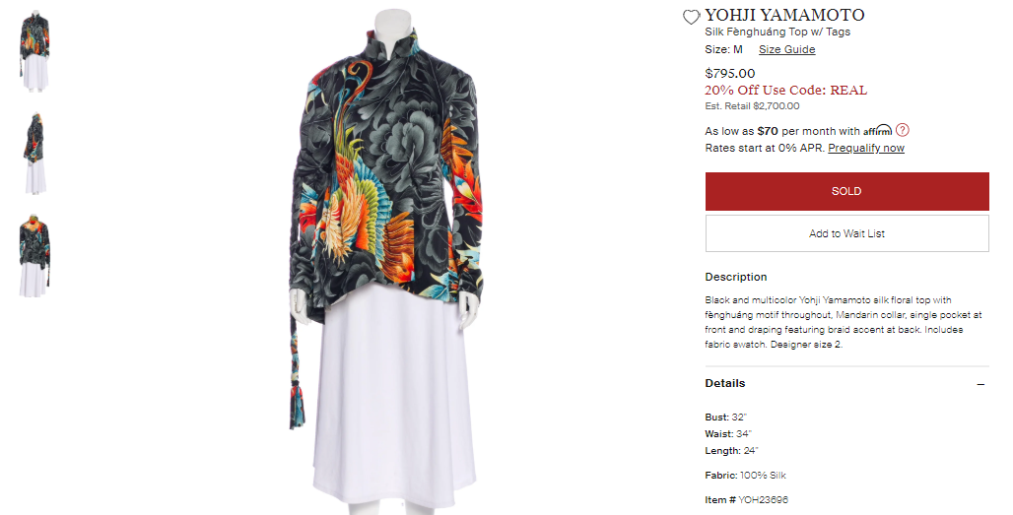
Culture – The fènghuáng (凤凰) is a bird of Chinese mythology. Originating from the sun, its form represents the celestial bodies: the sky (head), the sun (eyes), the moon (back), the wind (wings), the Earth (feet), and the planets (tail). Its form also signifies virtue (head), benevolence (chest), trust (abdomen), propriety (back), and righteousness (wings). A symbol of the Imperial House along with the dragon, it is said to live in the Kunlun Mountains and appears only in places of utmost peace, prosperity and happiness.
Yohji Yamamoto Silk Fènghuáng Top w/Tags
Black and multicolor Yohji Yamamoto silk floral top with fènghuáng motif throughout, Mandarin collar, single pocket at front and draping featuring braid accent at back. Includes fabric swatch.
Special collateral enhances value and convenience.

Slide 15
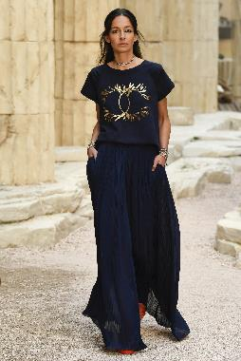
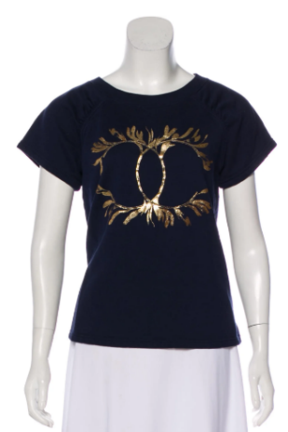
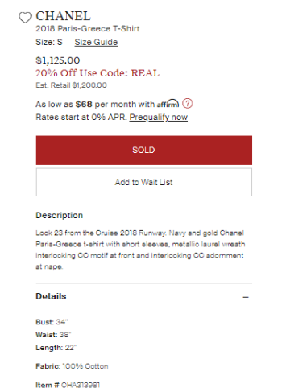
Paris-Greece -- Chanel has a tradition of centering two collections per year on a specific location, with designs inspired by the culture, history and artistry of the locale and blockbuster shows staged on site.
Culture -- the laurel wreath was an ancient Greek symbol of victory worn by Apollo (Ἀπόλλων), the god of the sun, knowledge, healing, music and archery. Wreaths from bay laurel and olive trees were placed on the heads of victors at the Olympics and at war.
Brand signature – the logo is the greatest value driver for luxury fashion. The interlocking CC monogram is the most recognizable symbol of the Chanel brand.
Recency (especially within the past 3 years) adds value to pre-owned products. Citing the seasonal collection places the item within the context of that collection’s themes and inspirations and the overall brand history. Runway items are selected by the creative director to showcase the season’s offering at its most eyecatching, innovative and symbolic. The pieces that appear on the runway are special as participants of a storied high fashion ritual and focal points of editorial shoots. I cited runway looks from shows covered by the preeminent fashion authority, Vogue.
Chanel 2018 Paris-Greece T-Shirt
Look 23 from the Cruise 2018 Runway. Navy and gold Chanel Paris-Greece t-shirt with short sleeves, metallic laurel wreath interlocking CC motif at front and interlocking CC adornment at nape.

Slide 16
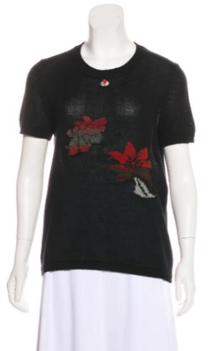
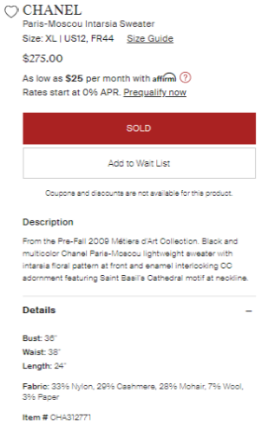
Citing the seasonal collection places the item within the context of that collection’s themes and inspirations and the overall brand history.
Brand signature -- “Professions of art” in French, Chanel shows an annual Métiers d’Art collection to showcase the talents of the artisanal specialty ateliers in partnership with the brand, like Maison Lesage (embroidery), Maison Michel (hats and headpieces), and Gripoix (poured glass), at their greatest extent.
Paris-Moscou -- Chanel has a tradition of centering two collections per year on a specific location, with designs inspired by the culture, history and artistry of the locale and blockbuster shows staged on site.
Terminology – intarsia is a knitting technique in which sections consisting of one thread color each are pieced together to create a garment.
Brand signature – the logo is the greatest value driver for luxury fashion. The interlocking CC monogram is the most recognizable symbol of the Chanel brand.
Culture -- Saint Basil’s Cathedral, or Sobor Vasiliya Blazhennovo (собо́р Васи́лия Блаже́нного), was built in Moscow in 1555 to commemorate the captures of the Kazan and Astrakhan Khanates. It was originally named Trinity Cathedral and consisted of nine churches, but in 1588, a tenth was built over the grave of Russian Orthodox Saint Basil, or Vasily (Василий), and the entire site was renamed in his honor. With its distinctive architecture unlike anything else in Russian history, Saint Basil’s Cathedral became a recognizable symbol for all of Russia.
Chanel Paris-Moscou Intarsia Sweater
From the Pre-Fall 2009 Métiers d’Art Collection. Black and multicolor Chanel Paris-Moscou lightweight sweater with intarsia floral pattern at front and enamel interlocking CC adornment featuring Saint Basil’s Cathedral motif at neckline.

Slide 17
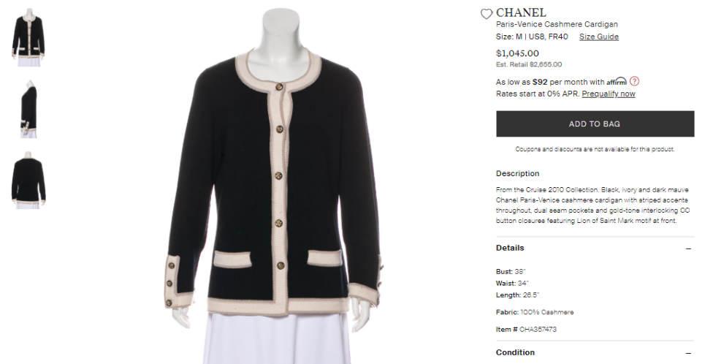
Citing the seasonal collection places the item within the context of that collection’s themes and inspirations and the overall brand history.
Paris-Venice -- Chanel has a tradition of centering two collections per year on a specific location, with designs inspired by the culture, history and artistry of the locale and blockbuster shows staged on site.
Brand signature – the logo is the greatest value driver for luxury fashion. The interlocking CC monogram is the most recognizable symbol of the Chanel brand.
Culture -- Evangelical Saint Mark, or San Marco, represented as a winged lion holding a Bible, is the symbol of Venice. It is said that when Saint Mark passed through Venice in the first century AD, an angel came to him and told him that his body would someday come to rest there. A bronze statue of the Lion of Saint Mark was erected in Venice in the twelfth century and remains there to this day.
Chanel Paris-Venice Cashmere Cardigan
From the Cruise 2010 Collection. Black, ivory and dark mauve Chanel Paris-Venice cashmere cardigan with striped accents throughout, dual seam pockets and gold-tone interlocking CC button closures featuring Lion of Saint Mark motif at front.

Slide 18
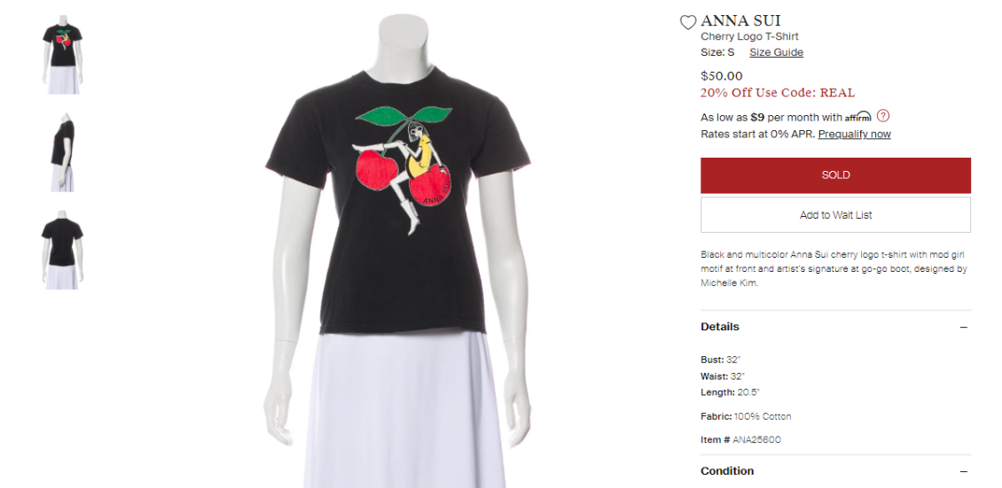
Culture – Mod was a British subculture of the early 1960s. Short for “modernist”, mod was associated with the most modern forms of jazz, ska and Merseybeat, tailor-made suits, mini dresses and skirts, dancing all night at clubs, and low-heeled footwear like go-go boots conducive to such dancing.
Inclusion of the artist’s signature in addition to the logo creates a sense of authenticity and uniqueness.
Anna Sui Cherry Logo T-Shirt
Black and multicolor Anna Sui cherry logo t-shirt with mod girl motif at front and artist’s signature at go-go boot, designed by Michelle Kim.
Artist -- Michelle Kim, Senior Designer at Anna Sui, has been with the brand since 2001, and also launched her own clothing line.

Slide 19
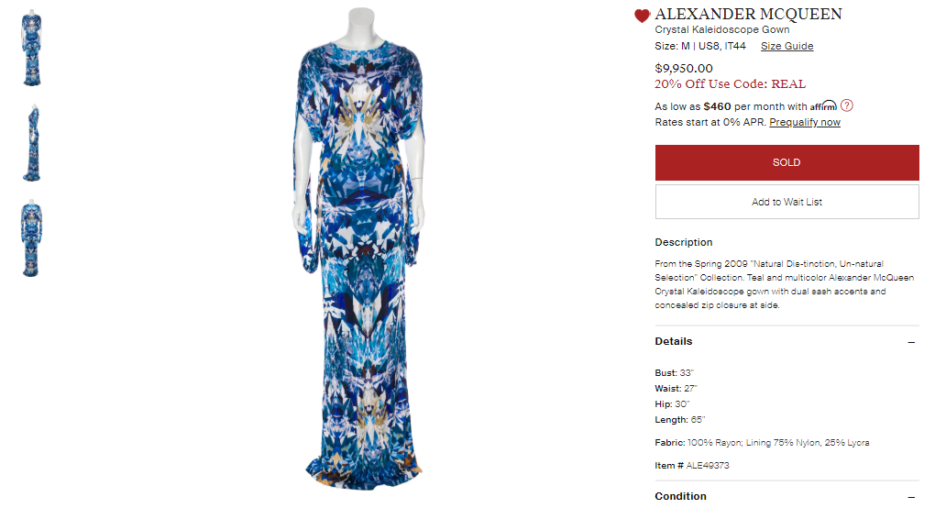
Citing the seasonal collection places the item within the context of that collection’s themes and inspirations and the overall brand history. Collections designed by Lee Alexander McQueen himself (predating his suicide in 2010) are especially valuable. The theme of the “Natural Dis-tinction, Un-natural Selection” collection was the application of evolutionary principles like “survival of the fittest” and “natural selection” to the species of post-Industrial Revolution Earth.
Alexander McQueen Crystal Kaleidoscope Gown
From the Spring 2009 “Natural Dis-tinction, Un-natural Selection” Collection. Teal and multicolor Alexander McQueen Crystal Kaleidoscope gown with dual sash accents and concealed zip closure at side.
Brand signature – Crystal Kaleidoscope is the brand’s official name for this geometric digital print.

Slide 20
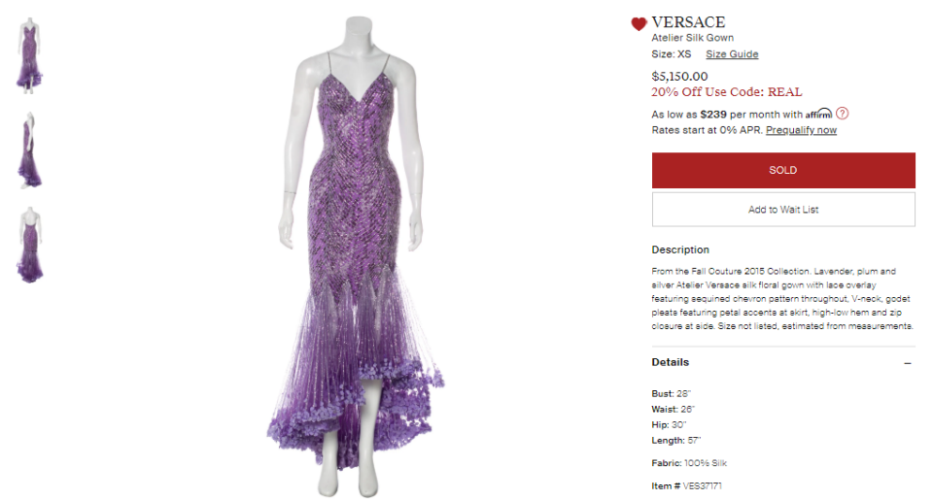
Atelier Versace is the name of the couture line, as distinguished from the mainline Versace brand.
Citing the seasonal collection places the item within the context of that collection’s themes and inspirations and the overall brand history. In the luxury fashion industry, couture designs are shown in separate collections from ready-to-wear. Haute couture, “high sewing” in French, is constructed entirely by hand, requiring days of labor by skilled artisans for a single piece. Pieces shown on the couture runway are later recreated from the beginning for each client.
Versace Atelier Silk Gown
From the Fall Couture 2015 Collection. Lavender, plum and silver Atelier Versace silk floral gown with lace overlay featuring sequined chevron pattern throughout, V-neck, godet pleats featuring petal accents at skirt, high-low hem and zip closure at side.
Terminology – godets are full circular pleats that add drama to a dress or skirt, with the benefit of allowing longer strides.
Petal – imbues the gown with an attribute of living things.

Slide 21
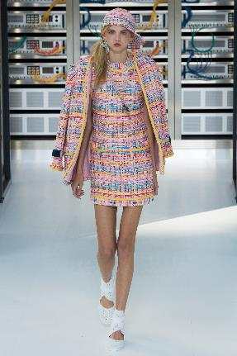
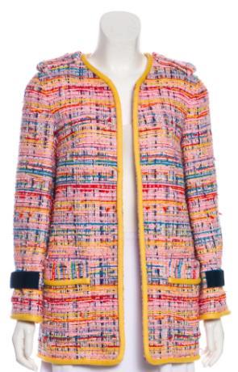
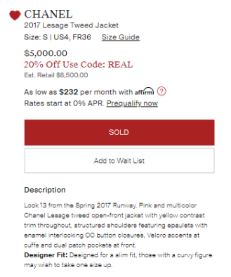
CHA293520
Brand signature -- Maison Lesage, a French embroidery atelier, has worked in partnership with Chanel since 1983. Lesage’s signature tweed is interwoven with strands of silk ribbon.
Brand signature – the logo is the greatest value driver for luxury fashion. The interlocking CC monogram is the most recognizable symbol of the Chanel brand.
Recency (especially within the past 3 years) adds value to pre-owned products. Citing the seasonal collection places the item within the context of that collection’s themes and inspirations and the overall brand history. Runway items are selected by the creative director to showcase the season’s offering at its most eyecatching, innovative and symbolic. The pieces that appear on the runway are special as participants of a storied high fashion ritual and focal points of editorial shoots. Some items from the runway are never mass-produced! I cited runway looks from shows covered by the preeminent fashion authority, Vogue.
Chanel 2017 Lesage Tweed Jacket
Look 13 from the Spring 2017 Runway. Pink and multicolor Chanel Lesage tweed open-front jacket with yellow contrast trim throughout, structured shoulders featuring epaulets with enamel interlocking CC button closures, Velcro accents at cuffs and dual patch pockets at front.

Slide 22
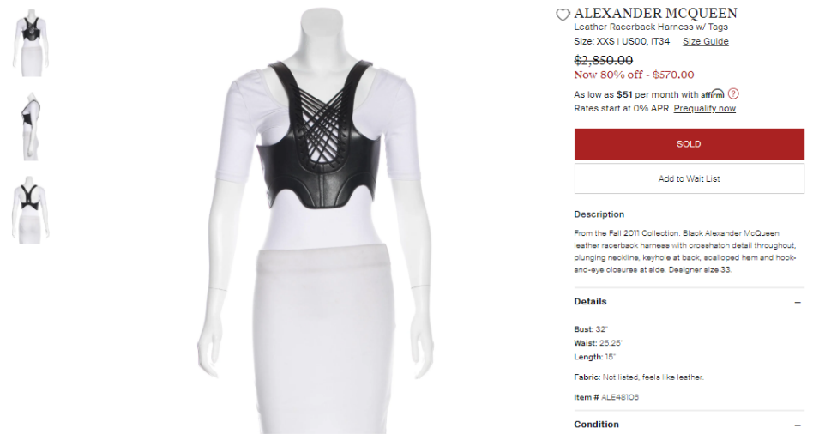
The seasonal collection places the item within the context of the collection’s themes and inspirations and the overall brand history.
Alexander McQueen Leather Racerback Harness w/Tags
From the Fall 2011 Collection. Black Alexander McQueen leather racerback harness with crosshatch detail throughout, plunging neckline, keyhole at back, scalloped hem and hook-and-eye closures at side. Designer size 33.

Slide 23
Menswear

Slide 24
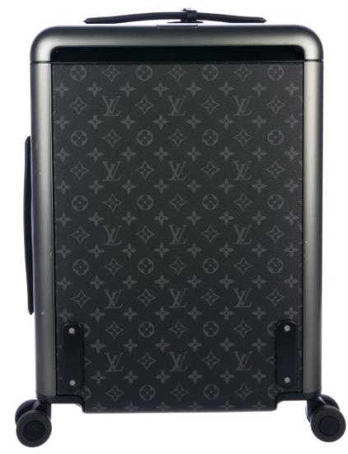
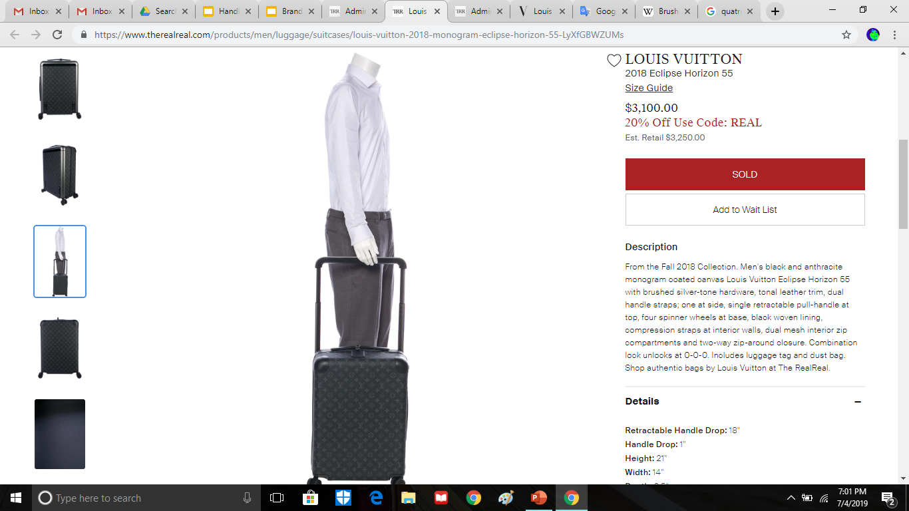
Recency (especially within the past 3 years) adds value to pre-owned products. Citing the seasonal collection places the item within the context of the overall brand history.
LOU199897
Brand signature – color specific to Louis Vuitton.
Brand signature – consisting of the LV Initiales and quatrefoil Fleurs of transposing colors, the monogram is the most recognizable symbol of the Louis Vuitton brand.
Material -- coated canvas is cotton canvas coated with polyvinyl chloride (PVC), creating a smoother texture and slightly glossier appearance.
Brand signature – Eclipse is a term Louis Vuitton uses for its monogram pattern when rendered in black and anthracite.
Style name – components of brand identity, style names are SEO aids that enhance searchability on a site with millions of products.
SEO meta description
Size – a smaller size means a lower price but less storage.
Louis Vuitton 2018 Eclipse Horizon 55
From the Fall 2018 Collection. Men's black and anthracite monogram coated canvas Louis Vuitton Eclipse Horizon 55 with brushed silver-tone hardware, tonal leather trim, dual handle straps; one at side, single retractable pull-handle at top, four spinner wheels at base, black woven lining, compression straps at interior walls, dual mesh interior zip compartments and two-way zip-around closure. Combination lock unlocks at 0-0-0. Includes luggage tag and dust bag. Shop authentic bags by Louis Vuitton at The RealReal.
Terminology – an brushed finish is a process applied to metal to give it a glossy, modern look, that can be achieved by rubbing the surface with sandpaper in one direction.
Terminology – spinner wheels spin independently from the spinning joint attaching them to the body of the suitcase. This increases ease and flexibility in maneuvering sharp turns.
Customer transparency – without brand-issued instructions, it was up to The RealReal to communicate with consignors about how to unlock and lock their luggage items and to transmit this information to customers.
Special collateral enhances value and convenience.

Slide 25
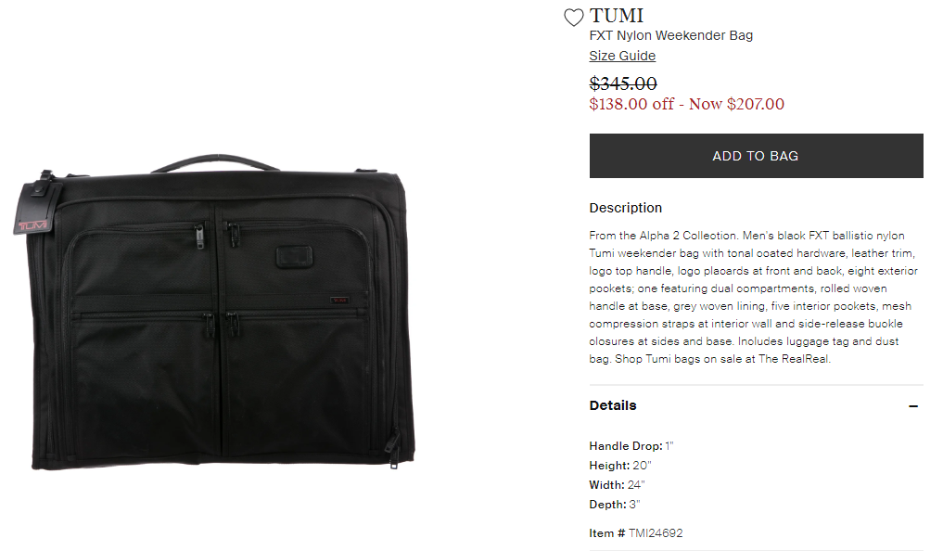
Collection name -- Alpha 2 is a collection of business and travel bags and luggage focused on engineering, functionality, and performance.
Brand signature – FXT ballistic nylon is a patented Tumi fabric that is extremely durable and protects the product from abrasions, with the implication that any projectile to hit this bag would bounce right off.
Interior features are the most crucial to product copy because they are not apparent in the photography.
Special collateral enhances value and convenience.
SEO meta description
Tumi Nylon Weekender Bag
From the Alpha 2 Collection. Men’s black FXT ballistic nylon Tumi weekender bag with tonal coated hardware, leather trim, logo top handle, logo placards at front and back, eight exterior pockets; one featuring dual compartments, rolled woven handle at base, grey woven lining, five interior pockets, mesh compression straps at interior wall and side-release buckle closures at sides and base. Includes luggage tag and dust bag. Shop Tumi bags on sale at The RealReal.

Slide 26
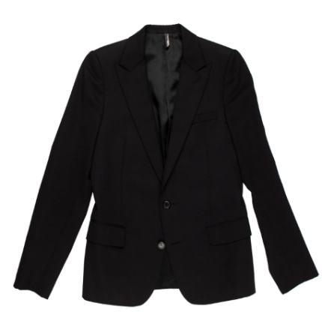
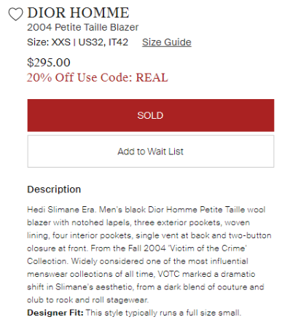
Creative director – Hedi Slimane (2001-2007) was an especially notable creative director of Dior Homme (Dior Men as of Spring 2018), launching a skinny, monochrome black silhouette that took off across the industry. David Bowie even wore his designs on tour!
HMM26544
Brand signature – “Small size” in French, Petite Taille is the brand’s official term for its size XXS clothing.
Interior features are the most crucial to product copy because they are not apparent in the photography.
Citing the seasonal collection places the item within the context of the overall brand history. In the case of a 2004 collection, there is also a sense of nostalgia.
Collection name – The Victim of the Crime collection was named after the song from French indie pop band Phoenix’s second album, Alphabetical. Every season, Slimane commissioned a band, usually one that was new or not widely known, to either compose an original song or create a remix of one of their existing songs for the Dior Homme show. The month following the show, Alphabetical was officially released and Phoenix achieved mainstream success.
Dior Homme 2004 Petite Taille Blazer
Hedi Slimane Era. Men's black Dior Homme Petite Taille wool blazer with notched lapels, three exterior pockets, woven lining, four interior pockets, single vent at back and two-button closure at front. From the Fall 2004 'Victim of the Crime' Collection. Widely considered one of the most influential menswear collections of all time, VOTC marked a dramatic shift in Slimane's aesthetic, from a dark blend of couture and club to rock and roll stagewear.

Slide 27
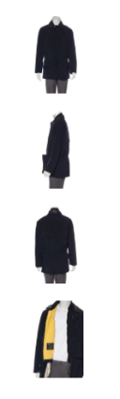
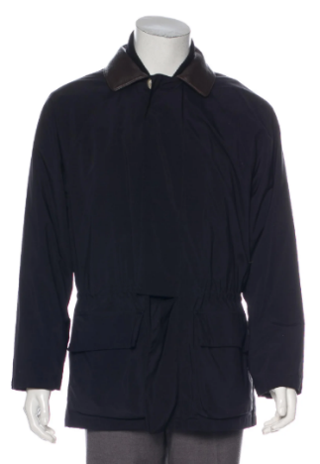
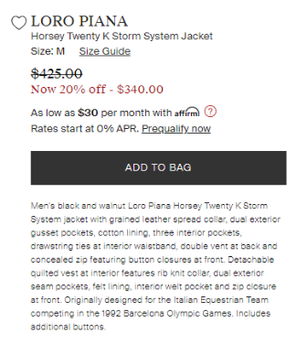
Style name – components of brand identity, style names are SEO aids that enhance searchability on a site with millions of products for sale at any given time.
LOR55378
Brand signature – Storm System is Loro Piana’s proprietary treatment of waterproof, wind-resistant membranes that can be applied to even the most delicate natural fibers, like vicuña and baby cashmere.
Terminology – a gusset pocket is a pocket consisting entirely of a new patch of fabric sewn on top of the body of the garment. Large, square and expandable, gusset pockets have a utilitarian value and aesthetic and are most commonly used in outerwear and cargo pants.
Interior features are the most crucial to product copy because they are not apparent in the photography. This product is in fact two items – a jacket and vest – in one, warranting a higher price.
Special collateral enhances value and convenience.
Loro Piana Horsey Twenty K Storm System Jacket
Men’s black and walnut Loro Piana Horsey Twenty K Storm System jacket with grained leather spread collar, dual exterior gusset pockets, cotton lining, three interior pockets, drawstring ties at interior waistband, double vent at back and concealed zip featuring button closures at front. Detachable quilted vest at interior features rib knit collar, dual exterior seam pockets, felt lining, interior welt pocket and zip closure at front. Originally designed for the Italian Equestrian Team competing in the 1992 Barcelona Olympic Games. Includes additional buttons.
Culture -- founded in Trivero, Italy in the early 19th century, the Loro Piana brand has always championed their Italian heritage and has partnered with the Italian Equestrian Sports Federation (FISE) since 1985.

Slide 28
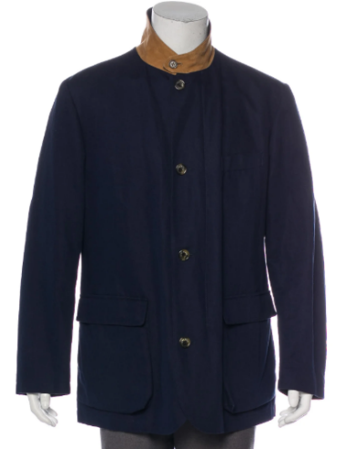
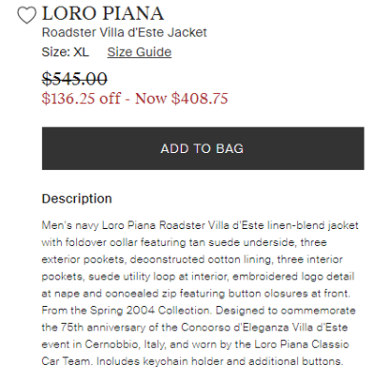
Style name – components of brand identity, style names are SEO aids that enhance searchability on a site with millions of products for sale at any given time.
LOR55978
Special functions and collateral enhance value and convenience. This collar can be worn in two ways: as a constrasting suede Mandarin collar with a navy logo detail at the back, or as a tonal pointed spread collar for a more understated look.
Terminology – most commonly found in handbags and backpacks, utility loops are elastic loops of fabric sewn to the body of a garment that keep small objects, like pens and cigarette lighters, secure.
Citing the seasonal collection places the item within the context of the overall brand history. In the case of a 2004 collection, there is also a sense of nostalgia.
Culture -- founded in Trivero, Italy in the early 19th century, the Loro Piana brand has always championed their Italian heritage. The Concorso d’Eleganza Villa d’Este is a classic and vintage car show hosted at Lake Como since 1929.
Brand signature – Loro Piana has sponsored a Classic Car Team to compete in 18 races for historic cars, including the Coppa d’Oro delle Dolomiti (Gold Cup of the Dolomites) in Cortina, Italy.
Loro Piana Roadster Villa d’Este Jacket
Men’s navy Loro Piana Roadster Villa d’Este linen-blend jacket with foldover collar featuring tan suede underside, three exterior pockets, deconstructed cotton lining, three interior pockets, suede utility loop at interior, embroidered logo detail at nape and concealed zip featuring button closures at front. From the Spring 2004 Collection. Designed to commemorate the 75th anniversary of the Concorso d’Eleganza Villa d’Este event in Cernobbio, Italy, and worn by the Loro Piana Classic Car Team. Includes keychain holder and additional buttons.

Slide 29
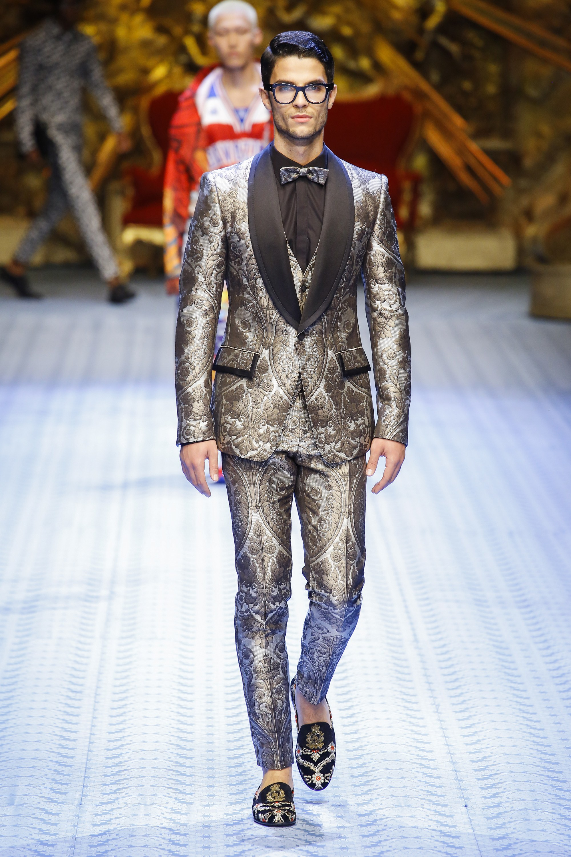
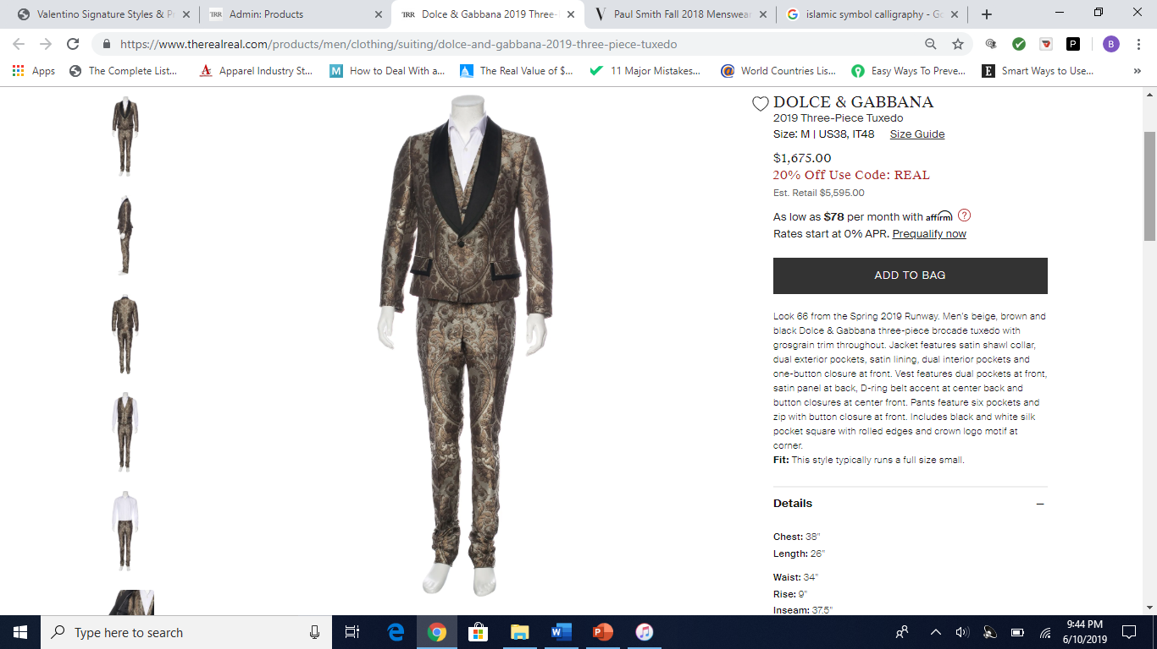
Recency (especially within the past 3 years) adds value to pre-owned products. Citing the seasonal collection places the item within the context of that collection’s themes and inspirations and the overall brand history. Runway items are selected by the creative director to showcase the season’s offering at its most eyecatching, innovative and symbolic. The pieces that appear on the runway are special as participants of a storied high fashion ritual and focal points of editorial shoots. Some items from the runway are never mass-produced! I cited runway looks from shows covered by the preeminent fashion authority, Vogue.
DAG151506
Interior features are the most crucial to product copy because they are not apparent in the photography.
Special collateral enhances value and convenience.
Dolce & Gabbana 2019 Three-Piece Tuxedo
Look 66 from the Spring 2019 Runway. Men’s beige, brown and black Dolce & Gabbana three-piece brocade tuxedo with grosgrain trim throughout. Jacket features satin shawl collar, dual exterior pockets, satin lining, dual interior pockets and one-button closure at front. Vest features dual pockets at front, satin panel at back, D-ring belt accent at center back and button closures at center front. Pants feature five pockets and zip with button closure at front. Includes black and white silk pocket square with rolled edges and crown logo motif at corner.

Slide 30

Recency (especially within the past 3 years) adds value to pre-owned products. Citing the seasonal collection places the item within the context of that collection’s themes and inspirations and the overall brand history.
Brand signature – Every Maison Margiela collection has a Replica capsule collection of about 30 products that are inspired by, and strive to replicate, timeless styles across continents and eras.
Maison Margiela 2017 Replica Wool-Blend Sweater
From the Fall 2017 Replica Collection. Men’s creme, light brown and red Maison Margiela wool-blend sweater with striped accents throughout and fringe trim. Inspired by hand-knitted children’s jumpers of 1970s Paris.

Slide 31

Citing the collection year places the item within the overall brand history.
Collaboration – Khumbu Climbing School, or the Khumbu Climbing Center, teaches technical mountain climbing skills to the residents of Phortse, Nepal, a Sherpa town of 300 located 13,000 feet above sea level in the Himalayas, near Mount Everest and Ama Dablam. Since there are no roads leading in and out of Phortse, climbing skills are necessary, and incorrect technique has caused many deaths. Khumbu Climbing School helps Phortse residents to be safe and to work as porters for the people who come from across the world to climb Mount Everest. Proceeds from the North Face collection went to the school, which is fitting as the brand uses the term “Sherpa” to describe its thicker fleece products.
The North Face Khumbu Climbing School Hooded Jacket
From the 2009 capsule collection in partnership with Khumbu Climbing School in Phortse, Nepal. Men’s black The North Face hooded jacket with satin pattern throughout, logo appliqué at chest, dual mesh vents at underarms, dual zip pockets, felt lining, embroidered logo patches at back; one featuring the Eternal Knot and logo zip closure at front.
Culture – Dating back to the Indus Valley Civilization of modern-day India and Pakistan (2500 BCE), the Eternal Knot, or Dpal Be’u (དཔལ་བེའུ།) in Tibetan, is one of the Eight Auspicious Symbols, or Ashtamangala, of Buddhism. It symbolizes Khor Ba (འཁོར་བ་ ), the eternal cycle of birth, death, and reincarnation, and the union of emptiness, or tongpa nyi (སྟོང་པ་ཉིད་ ), and dependent origination, or ten-ching drelwar jungwa (རྟེན་ཅིང་འབྲེལ་བར་འབྱུང་བ་ ), underlying our existence.

Slide 32

Sandro New Order: Power Corruption and Lies T-Shirt
Men’s black and multicolor Sandro Power Corruption and Lies T-shirt with graphic featuring the cover art of British synth-pop band New Order’s 1983 album at front.

Slide 33
Books
The RealReal’s curated selection of books mirrors their fashion and art product. I took care to summarize each book that came to my desk with respect for the terminology of its subject matter and the backgrounds of its principal actors, and to identify the features that would entice a reader most. Without time to read the books cover to cover, this required research and intuition.

Slide 34



First Edition – age and scarcity increase the item’s value.
BOOOK22929
Although I typically cite one author and one photographer, I included two of the three photographers because Bruce Weber and Richard Avedon are both famous among fashion industry aficionados, with work spanning eight decades for brands like Christian Dior, Ralph Lauren, and Calvin Klein and magazines like Vogue, Harper’s Bazaar, Elle, GQ, and Vanity Fair.
Juxtaposing Versace’s nickname with his given name creates a feeling of endearment for the legendary figure.
The Art of Being You, Abbeville Press
First Edition. Hardcover book, titled The Art of Being You, published by Abbeville Press in 1997, written by Gianni Versace and photographed by Bruce Weber and Richard Avedon, a 256-page mood board of Italian fashion designer Giovanni “Gianni” Versace’s eclectic personal art collection and other inspirations.
I used the term “mood board”, a staple practice of the fashion industry, as a metaphor for the book’s content, a series of photographs of objects, people and scenes, conceptually unrelated but linked by visual and emotional similarities, that served the mood board function of providing inspiration for Versace over the course of his lifetime. The photographs could conceivably be constructed into a 64 x 64 page mood board instead of a book with the same vibrant resonance and very little loss of meaning (i.e. there was not much text).

Slide 35

I assessed the list of profiled designers and selected the ones I felt would be most resonant for today’s readers.
The Art of Haute Couture, Abbeville Press
Hardcover book, titled The Art of Haute Couture, published by Abbeville Press in 1995, written by Laura Jacobs and photographed by Victor Skrebneski, detailing the fabrics, ornaments and techniques that elevate clothing to the level of fantasy through the work of twentieth-century couturiers like Christian Dior, Yves Saint Laurent and Elsa Schiaparelli.

Slide 36



Culture – Hard-edge is a technical term for any painting with abrupt transitions between color areas. Hard-edge painting was also a movement that began in California in 1952 as a reaction to Abstract expressionism. Helen Lundeberg was one of the movement’s six principal figures.
Culture – Post-surrealism was an artistic movement founded by Helen Lundeberg and Loris Feitelson in California in their 1934 manifesto and became an American differentiation from French surrealism.
Infinite Distance: Architectural Compositions, Louis Stern Fine Arts
Hardcover book, titled Infinite Distance: Architectural Compositions, published by Louis Stern Fine Arts in 2007, written by Marie Chambers and photographed by Ed Glendinning, detailing the Hard-edge Post-Surrealist work of American painter Helen Lundeberg.

Slide 37

Michael Glancy: Infinite Obsessions, Arnoldsche Art Publishers
Hardcover book, titled Michael Glancy: Infinite Obsessions, published by Arnoldsche Art Publishers in 2011, written by Barry Friedman, detailing the colorful and kaleidoscopic works of American glass sculptor Michael Glancy from 1998-2010, as shown at his Summer 2011 exhibition in New York.

Slide 38

Hidden Forms, Birkhäuser Architecture
Hardcover book, titled Hidden Forms, published by Birkhäuser Architecture in 2009, written by Franco Clivio, Industrial Design Department director at Zürich University of the Arts, and photographed by Hans Hansen, detailing Clivio’s vast and meticulously presented collection of seemingly ordinary everyday objects, united by their ability to solve fundamental problems in unconventional ways.

