Slide 1
Magnetic Me – Social Media
As a Marketing and Public Relations Intern at Magnetic Me (formerly Magnificent Baby), I channeled their whimsical yet sophisticated brand voice from their origins as a smart and visionary brand. Co-founder Lauren Levy invented the use of magnetic closures for baby clothing as an alternative to snaps, making it much easier for parents to dress moving babies, and has a patent on her Smart Close technology (a pun on “smart clothes”). I directed this intelligence and wit into detailed Facebook posts and Instagram captions. Below are a few choice posts, both as they appeared online and demarcated in black boxes, and annotations (in color) of the significance behind them.
Facebook
Instagram
Twitter
Pinterest

Slide 2
Facebook
Campaign: Why It’s Magnificent
Event: Magnificent Baby Casting Call

Slide 3
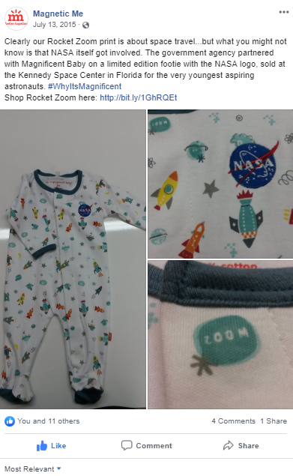
Clearly our Rocket Zoom print is about space travel…but what you might not know is that NASA itself got involved. The government agency partnered with Magnificent Baby on a limited edition footie with the NASA logo, sold at the Kennedy Space Center in Florida for the very youngest aspiring astronauts. #WhyItsMagnificent
Shop Rocket Zoom here:
Magnetic Me prints have been vibrant and unconventional from the beginning. While everyone can register these designs as “cute”, the “Why It’s Magnificent” campaign added resonance by telling the stories behind the prints and their inspirations.
By cross-referencing Facebook Insights and Google Analytics data, I found that we received an average of 50% more website visits on days when a link to the website was included in a Facebook post. Bit.ly abbreviated links made link inclusion more visually compatible with the posts.

Slide 4
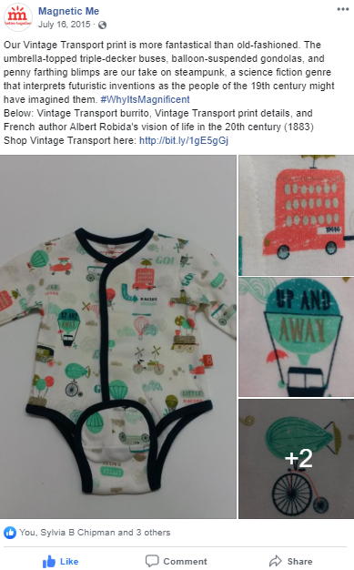
Our Vintage Transport print is more fantastical than old-fashioned. The umbrella-topped tripe-decker buses, balloon-suspended gondolas, and penny farthing blimps are our take on steampunk, a science fiction genre that interprets futuristic inventions as the people of the 19th century might have imagined them. #WhyItsMagnificent
Below: Vintage Transport burrito, Vintage Transport print details, and French author Albert Robida’s vision of life in the 20th century (1883)
Shop Vintage Transport here:

Slide 5
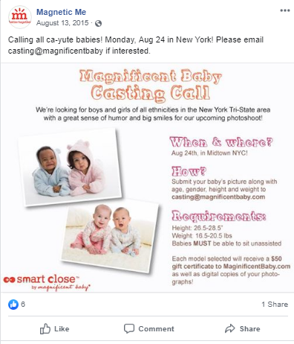
Calling all ca-yute babies! Monday, Aug 24 in New York! Please email casting@magnificentbaby.com if interested.
Magnetic Me had two photo shoots per year, for the Spring and Fall collections.

Slide 6
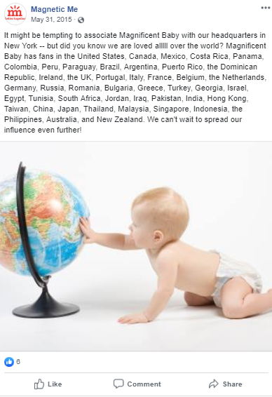
It might be tempting to associate Magnificent Baby with our headquarters in New York – but did you know we are loved alllll over the world? Magnificent Baby has fans in the United States, Canada, Mexico, Costa Rica, Panama, Colombia, Peru, Paraguay, Brazil, Argentina, Puerto Rico, the Dominican Republic, Ireland, the UK, Portugal, Italy, France, Belgium, The Netherlands, Germany, Russia, Romania, Bulgaria, Greece, Turkey, Georgia, Israel, Tunisia, South Africa, Jordan, Iraq, Pakistan, India, Hong Kong, Taiwan, China, Japan, Thailand, Malaysia, Singapore, Indonesia, the Philippines, Australia and New Zealand. We can’t wait to spread our influence even further!
These were the nations where Magnetic Me had stockists at the time. When I started at the company, I was struck by their incredible global reach considering they were only five years old and their headquarters consisted of one room with five full-time employees (including the two co-founders) and 1-3 interns. I thought customers should know about this as well. Psychologically speaking, people feel more persuaded to like things that other people already like, like a crowded restaurant, a full tip jar, or a baby clothing brand in more than 40 countries. I listed the countries (and Puerto Rico) in the order of a contiguous route that one might take to visit them all.

Slide 7
Instagram
Campaigns: Beach Day Giveaway, The Gift for Dad (that’s Really for Mom), Magnificent Baby of the Week, Prayers for Finn
Launches: Spring 2015 Collection, Fall 2015 Collection
Events: New York Baby Show, NY Now, Spring 2016 Photo Shoot
Public Relations: Beverley Mitchell
Featured Products: Wrist Rattles, Excess Inventory

Slide 8
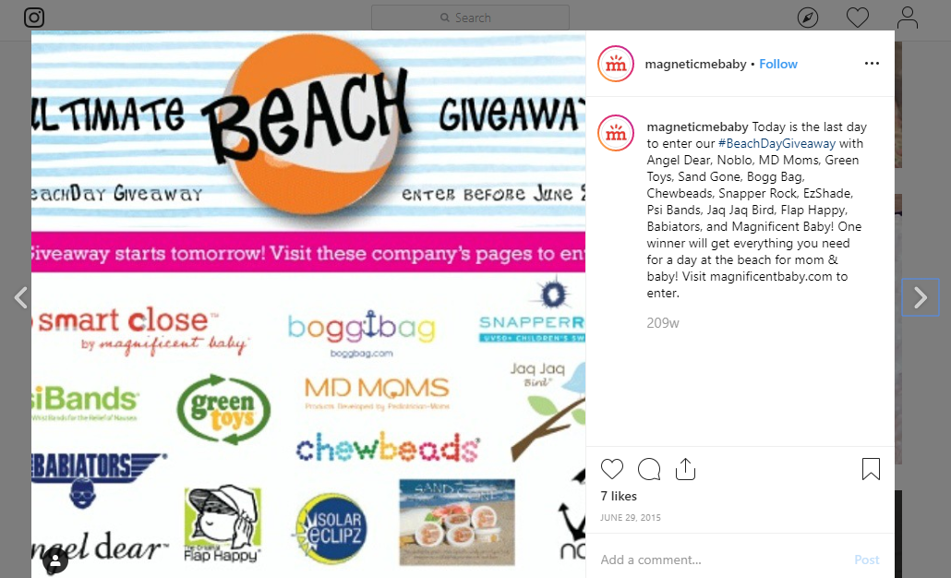
The Beach Day Giveaway was a partnership with 13 brands with complementary baby and beach products, in which one winner would receive a product from each brand. Liking the Facebook pages of all brands was required for entry (with an additional entry for each follow of another social media account). The result was thousands of new Magnetic Me followers!
Today is the last day to enter our #BeachDayGiveaway with Angel Dear, Noblo, MD Moms, Green Toys, Sand Gone, Bogg Bag, Chewbeads, Snapper Rock, EZShade, Psi Bands, Jaq Jaq Bird, Flap Happy, Babiators, and Magnificent Baby! One winner will get everything you need for a day at the beach for mom & baby! Visit magnificentbaby.com to enter.

Slide 9
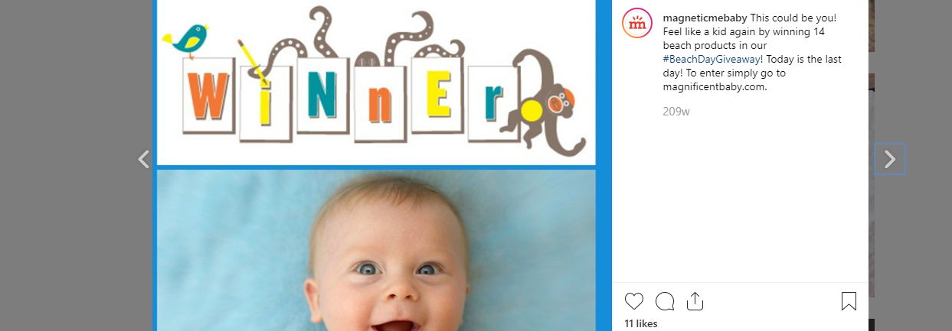
This could be you! Feel like a kid again by winning 14 beach products in our #BeachDayGiveaway! Today is the last day! To enter simply go to magnificentbaby.com.

Slide 10
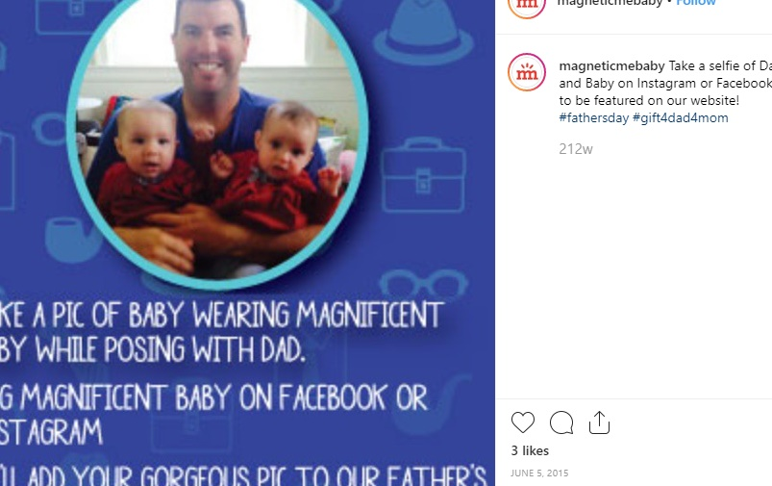
Since our social media following was 90% female, The Gift for Dad (that’s Really for Mom) was a cheeky spin on Father’s Day, a call to action for mothers to buy Magnetic Me products to give the fathers (on behalf of infant children too young to pick out gifts themselves). It was a joke about the tendency for people to give their significant other a gift, then use said gift more often than the significant other does.
Take a selfie of Dad and Baby on Instagram or Facebook to be featured on our website! #fathersday #gift4dad4mom

Slide 11
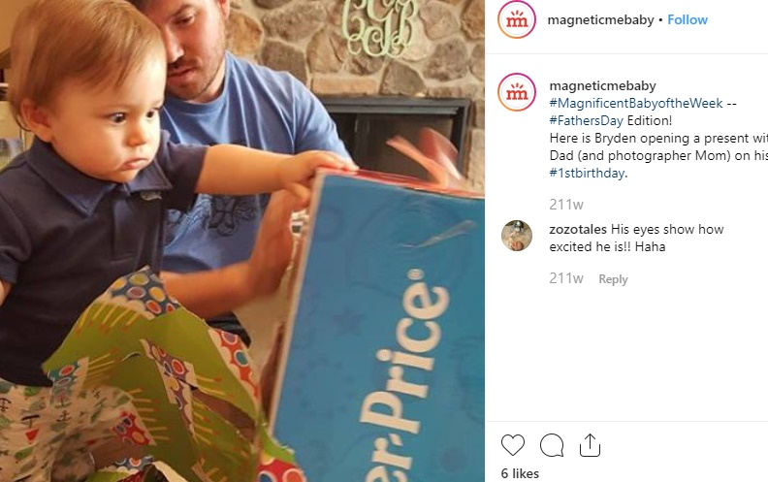
A customer entry from our Father’s Day campaign (with Bryden in our Nantucket Polo Set!).
#MagnificentBabyoftheWeek -- #FathersDay Edition! Here is Bryden opening a present with Dad (and photographer Mom) on his #1stbirthday.

Slide 12
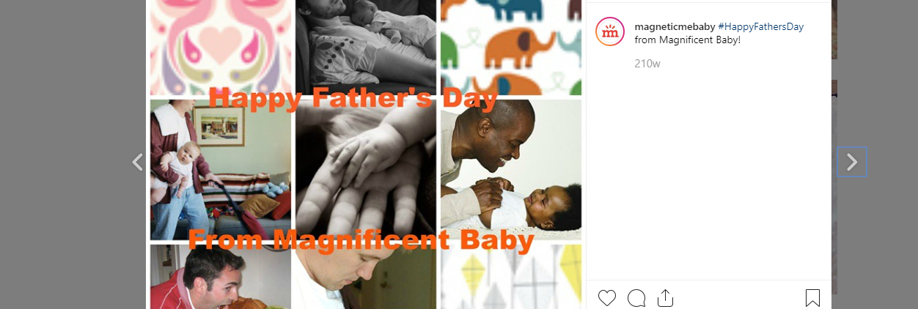
Our Love Birds, Elephants on Parade, and Kites prints paired with heartwarming and funny photos of fathers and babies from the Internet.
#HappyFathersDay from Magnificent Baby!

Slide 13
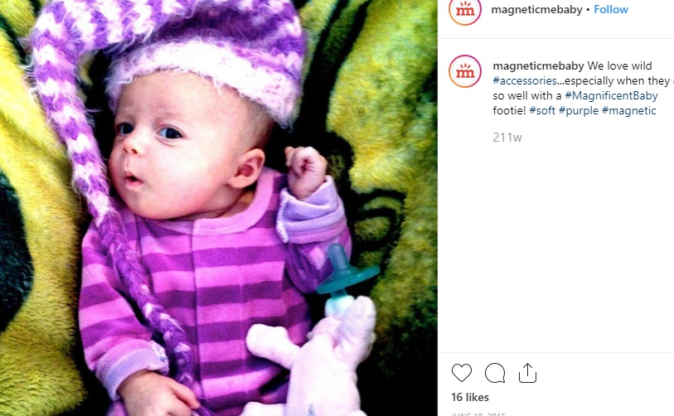
Magnificent Baby of the Week started as a weekly feature of a baby wearing Magnetic Me clothing on our website. When customers started tagging us on Instagram, I responded by reposting these photos, on a more-than-weekly basis, incentivizing those who enjoy Instagram attention (and a shot at the ever-elusive “Instagram fame”) to post photos of their babies and buy Magnetic Me products.
One of the Magnetic Me slogans is “Soft. Simple. Magnetic.” I used #soft #simple #magnetic hashtags and fun spins in which one word was substituted, like #soft #purple #magnetic.
We love wild #accessories…especially when they go so well with a #MagnificentBaby footie! #soft #purple #magnetic

Slide 14
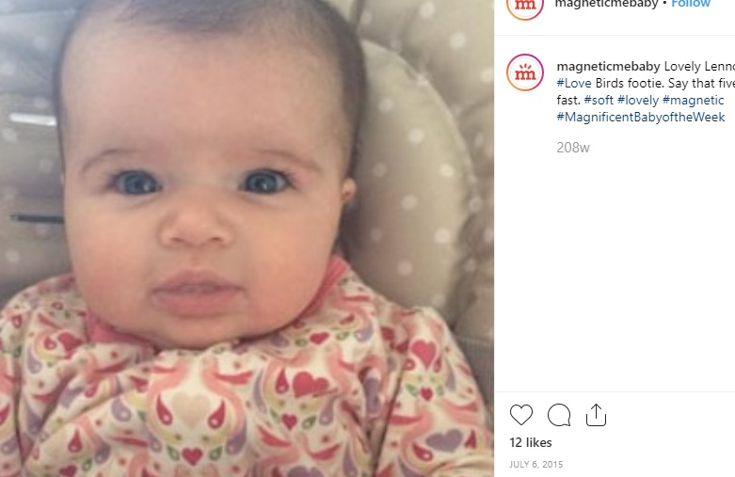
Magnificent Baby of the Week started as a weekly feature of a baby wearing Magnetic Me clothing on our website. When customers started tagging us on Instagram, I responded by reposting these photos, on a more-than-weekly basis, incentivizing those who enjoy Instagram attention (and a shot at the ever-elusive “Instagram fame”) to post photos of their babies and buy Magnetic Me products.
One of the Magnetic Me slogans is “Soft. Simple. Magnetic.” I used #soft #simple #magnetic hashtags and fun spins in which one word was substituted, like #soft #lovely #magnetic.
Lovely Lennon in a #Love Birds footie. Say that five times fast. #soft #lovely #magnetic #MagnificentBabyoftheWeek

Slide 15
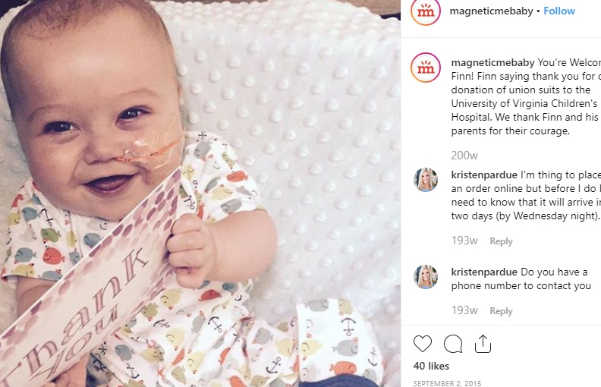
Prayers for Finn was not a marketing campaign in the traditional sense. Magnetic Me donated 50 union suits (short-sleeved, footless onesies) to babies with heart conditions magnetic closures make it much easier to dress babies who undergo frequent surgery and are hooked up to intravenous tubes. While we did not seek to benefit commercially from doing this, we did want people to know about it. I emailed with Finn’s mother throughout the donation process, and she was very happy to use Finn’s image to spread awareness.
You’re Welcome Finn! Finn saying thank you for our donation of union suits to the University of Virginia Children’s Hospital. We thank Finn and his parents for their courage.

Slide 16
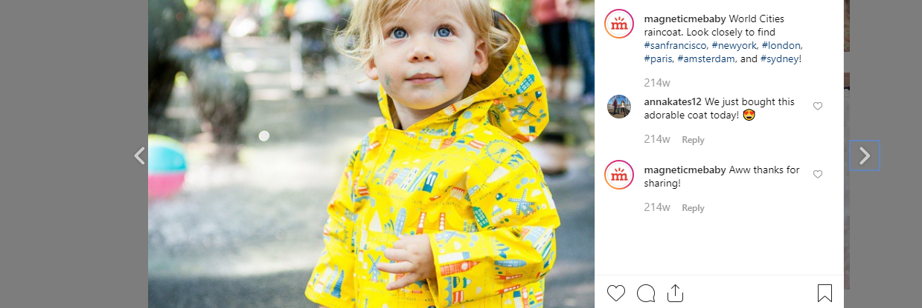
World Cities raincoat. Look closely to find #sanfrancisco, #newyork, #london, #paris, #amsterdam, and #sydney!
Spring 2015 Collection

Slide 17
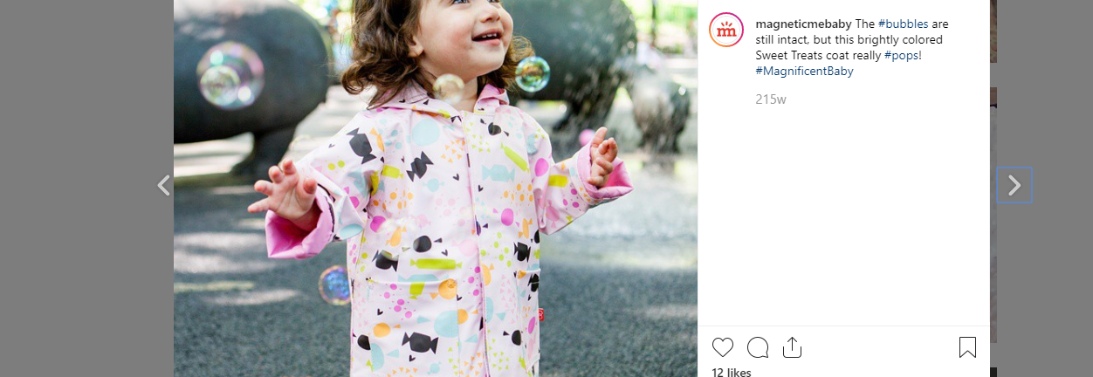
The #bubbles are still intact, but this brightly colored Sweet Treats coat really #pops! #MagnificentBaby
Spring 2015 Collection

Slide 18
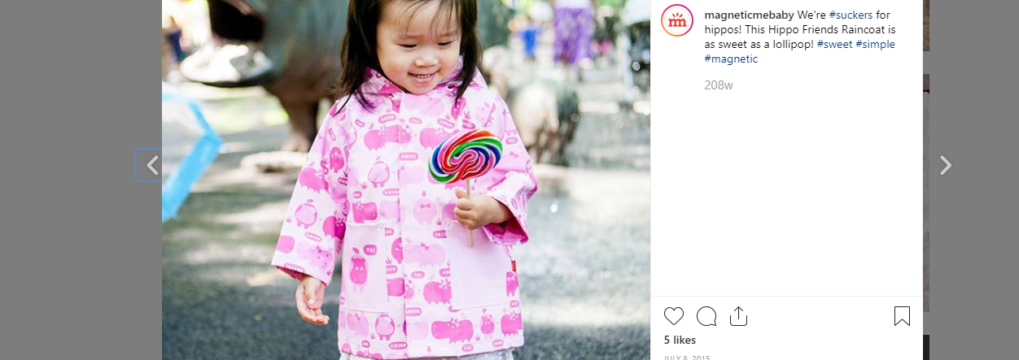
One of the Magnetic Me slogans is “Soft. Simple. Magnetic.” I used #soft #simple #magnetic hashtags and fun spins in which one word was substituted, like #sweet #simple #magnetic.
We’re #suckers for hippos! This Hippo Friends Raincoat is as sweet as a lollipop! #sweet #simple #magnetic
Spring 2015 Collection

Slide 19
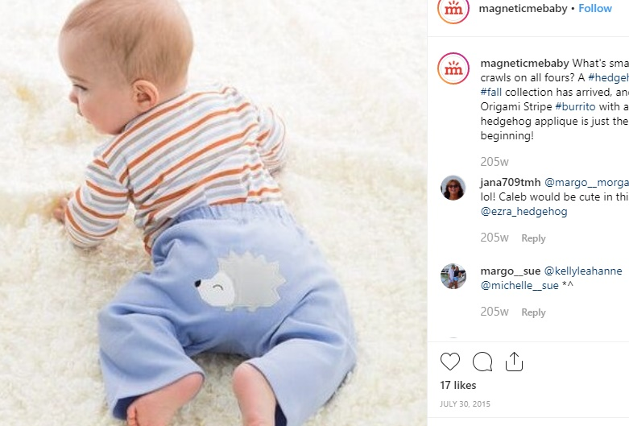
“Burrito” was a brand signature term for Magnetic Me bodysuits, which can be wrapped and unwrapped as easily as a burrito!
What’s small and crawls on all fours? A #hedgehog! Our #fall collection has arrived, and this Origami Stripe #burrito with a hedgehog applique is just the beginning!
Fall 2015 Collection

Slide 20
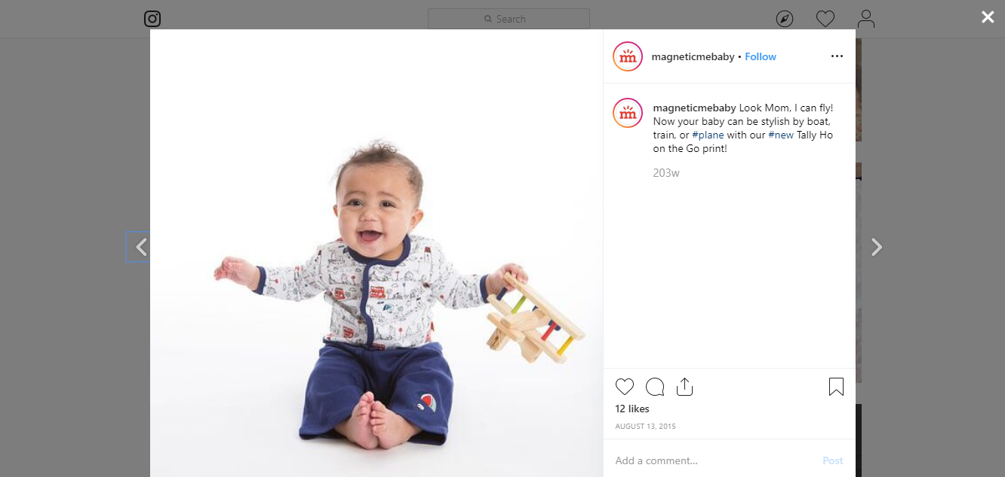
Look Mom, I can fly! Now your baby can be stylish by boat, train, or #plane with our #new Tally Ho on the Go print!
Fall 2015 Collection

Slide 21
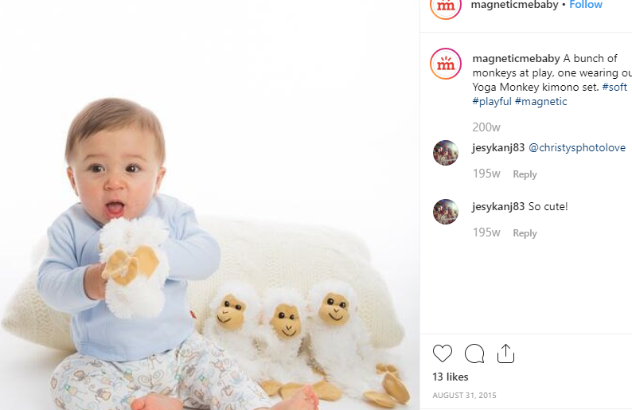
One of the Magnetic Me slogans is “Soft. Simple. Magnetic.” I used #soft #simple #magnetic hashtags and fun spins in which one word was substituted, like #soft #playful #magnetic.
A bunch of monkeys at play, one wearing our Yoga Monkey kimono set. #soft #playful #magnetic
Fall 2015 Collection

Slide 22
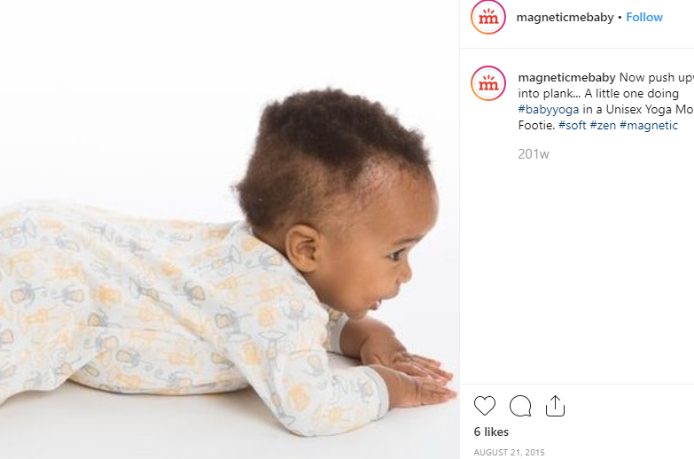
“Plank” is a yoga pose in which the back is straight and horizontal, the legs are off the floor, and the body is supported by the forearms and the feet. One could imagine someone in this baby’s position keeping their elbows and feet on the ground while lifting their stomach and legs upward.
One of the Magnetic Me slogans is “Soft. Simple. Magnetic.” I used #soft #simple #magnetic hashtags and fun spins in which one word was substituted, like #soft #zen #magnetic.
Now push upward into plank…A little one doing #babyyoga in a Unisex Yoga Monkey footie. #soft #zen #magnetic
Fall 2015 Collection

Slide 23
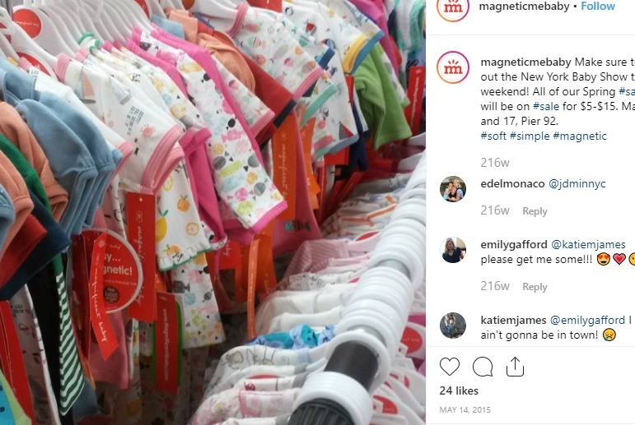
The New York Baby Show, or New York Baby Expo, is a sample sale for all things baby and a great opportunity for brand awareness.
Make sure to check out the New York Baby Show this weekend! All of our Spring #samples will be on #sale for $5-$15. May 16 and 17, Pier 92. #soft #simple #magnetic

Slide 24
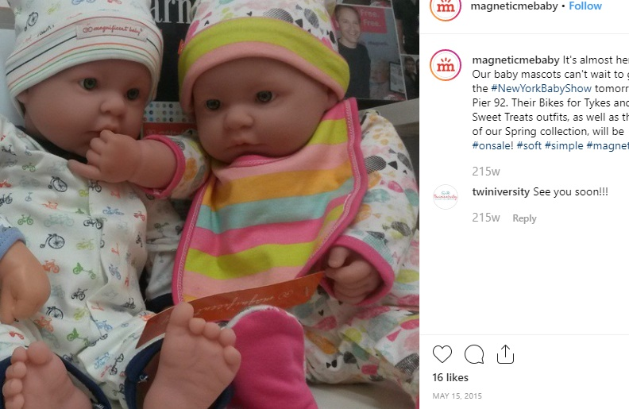
The New York Baby Show, or New York Baby Expo, is a sample sale for all things baby and a great opportunity for brand awareness.
I carried the baby doll on the right to network with bloggers at the event, providing demos of the Smart Close technology.
It’s almost here! Our baby mascots can’t wait to go to the #NewYorkBabyShow tomorrow at Pier 92. Their Bikes for Tykes and Sweet Treats outfits, as well as the rest of our Spring collection, will be #onsale! #soft #simple #magnetic

Slide 25
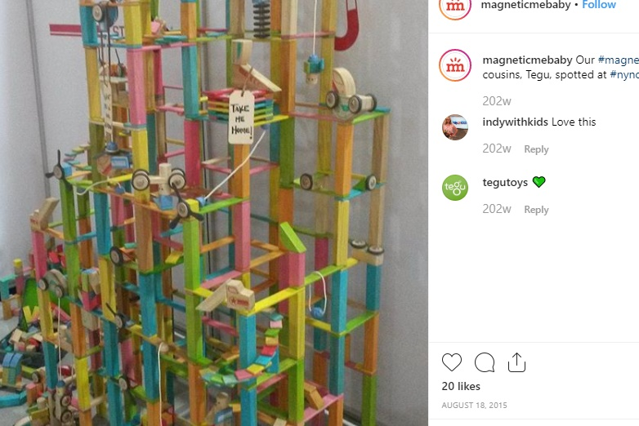
New York Now, or NY Now, is a trade show connecting vendors and buyers for many different categories, including Kids and Baby. People travel from all over the country to participate at the Javits Center in New York City.
Our #magnetic cousins, Tegu, spotted at #nynow.

Slide 26
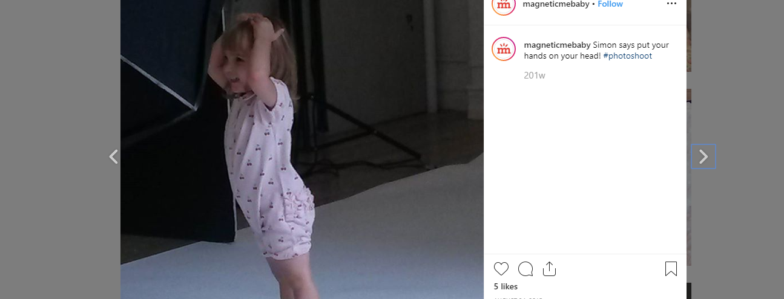
Simon says put your hands on your head! #photoshoot
Behind the scenes at the Spring 2016 photo shoot.

Slide 27
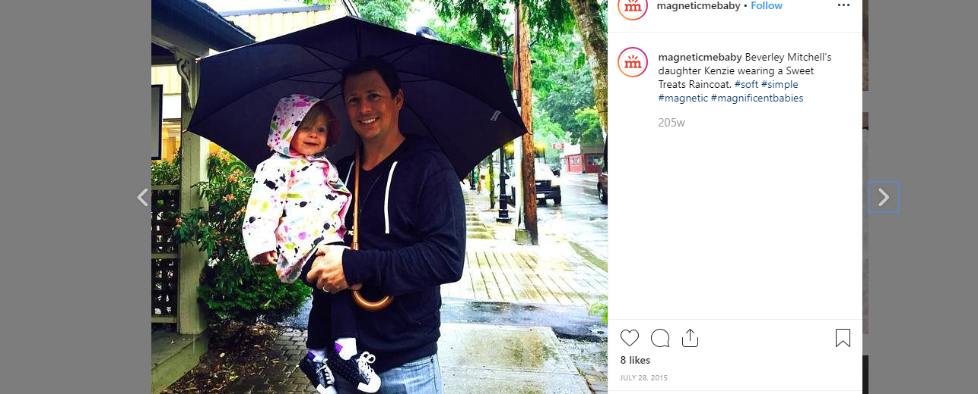
Beverley Mitchell’s daughter Kenzie wearing a Sweet Treats Raincoat. #soft #simple #magnetic #magnificentbabies

Slide 28
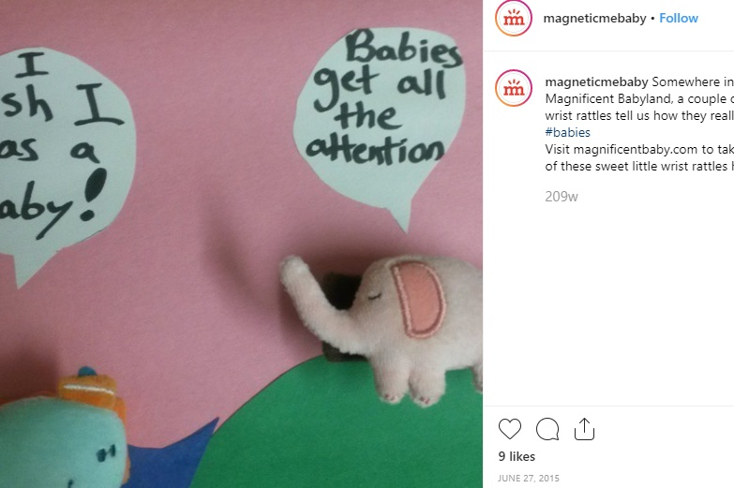
The website back end kept track of inventory levels for each SKU. Swaddle blankets were an underperforming category with more unsold inventory. I made a point of tailoring posts around these products (without, of course, revealing why). This strategy moved units; by cross-referencing Facebook Insights and Google Analytics data, I found that our 20 best-selling products were 5.3 times more likely to have appeared in a post than our 20 worst-selling products.
Somewhere in Magnificent Babyland, a couple of wrist rattles tell us how they really feel. #babies Visit magnificentbaby.com to take one of these sweet little wrist rattles home!

Slide 29
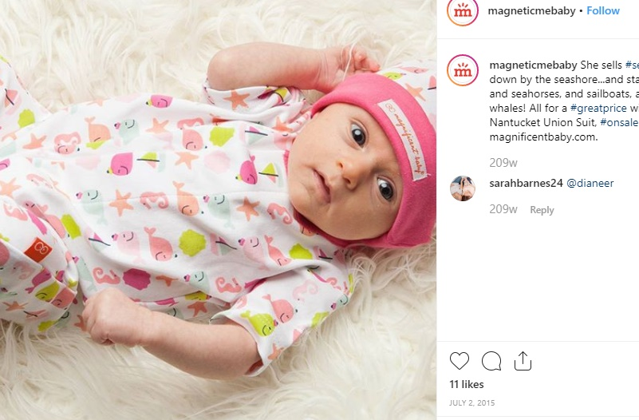
The website back end kept track of inventory levels for each SKU. While our seasonal collections were going strong, Magnetic Me faced an issue of older products, launched when they were lesser-known, taking up a significant share of space on the website and in the warehouse, in broken size runs that were difficult to sell to our accounts. I made a point of tailoring posts around these products (without, of course, revealing why). This strategy moved units; by cross-referencing Facebook Insights and Google Analytics data, I found that our 20 best-selling products were 5.3 times more likely to have appeared in a post than our 20 worst-selling products.
She sells #seashells down by the seashore…and starfish, and seahorses, and sailboats, and whales! All for a #greatprice with this Nantucket Union Suit, #onsale at magnificentbaby.com.

Slide 30
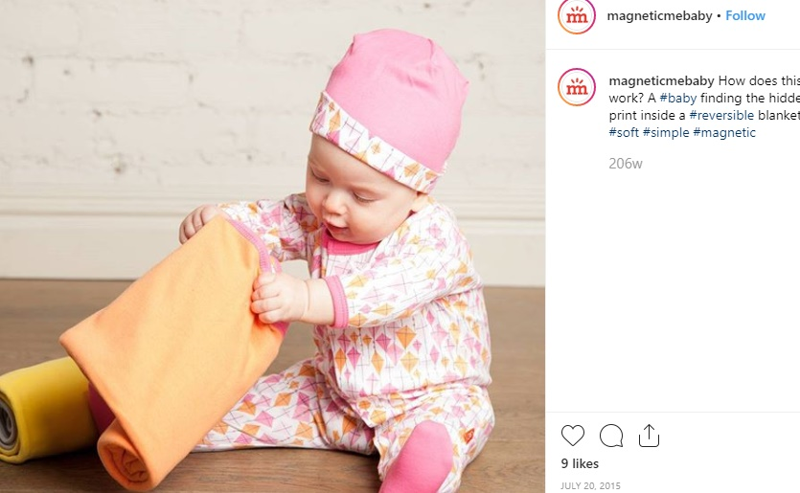
The website back end kept track of inventory levels for each SKU. While our seasonal collections were going strong, Magnetic Me faced an issue of older products, launched when they were lesser-known, taking up a significant share of space on the website and in the warehouse, in broken size runs that were difficult to sell to our accounts. I made a point of tailoring posts around these products (without, of course, revealing why). This strategy moved units; by cross-referencing Facebook Insights and Google Analytics data, I found that our 20 best-selling products were 5.3 times more likely to have appeared in a post than our 20 worst-selling products.
How does this work? A #baby finding the hidden print inside a #reversible blanket. #soft #simple #magnetic

Slide 31
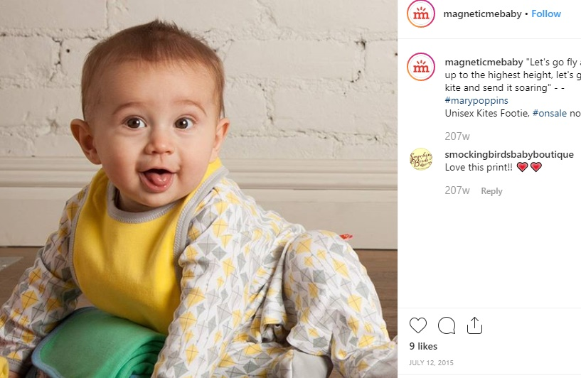
The website back end kept track of inventory levels for each SKU. While our seasonal collections were going strong, Magnetic Me faced an issue of older products, launched when they were lesser-known, taking up a significant share of space on the website and in the warehouse, in broken size runs that were difficult to sell to our accounts. I made a point of tailoring posts around these products (without, of course, revealing why). This strategy moved units; by cross-referencing Facebook Insights and Google Analytics data, I found that our 20 best-selling products were 5.3 times more likely to have appeared in a post than our 20 worst-selling products.
“Let’s go fly a kite, up to the highest height, let’s go fly a kite and send it soaring...” -- #marypoppins Unisex Kites Footie. #onsale now!

Slide 32
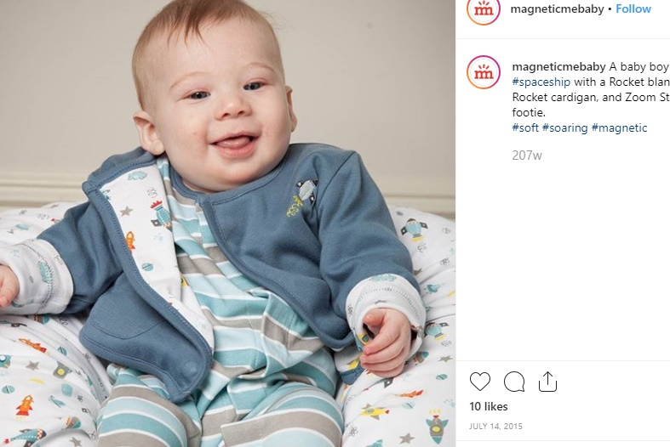
The website back end kept track of inventory levels for each SKU. While our seasonal collections were going strong, Magnetic Me faced an issue of older products, launched when they were lesser-known, taking up a significant share of space on the website and in the warehouse, in broken size runs that were difficult to sell to our accounts. I made a point of tailoring posts around these products (without, of course, revealing why). This strategy moved units; by cross-referencing Facebook Insights and Google Analytics data, I found that our 20 best-selling products were 5.3 times more likely to have appeared in a post than our 20 worst-selling products.
A baby boy playing #spaceship with a Rocket blanket, Rocket cardigan and Zoom Stripes footie. #soft #soaring #magnetic

Slide 33
Twitter
Campaign: Prayers for Finn
Public Relations: Pregnancy & Newborn, Jenna Bush Hager, Bergenmamacita
Event: Spring 2016 Photo Shoot
Trending Hashtags: #WorldPhotographyDay, #WomensEqualityDay, #FlashbackFriday, #FriendshipDay, #CalmYourselfIn4Words
Featured Products: Swaddle Blankets, Excess Inventory

Slide 34
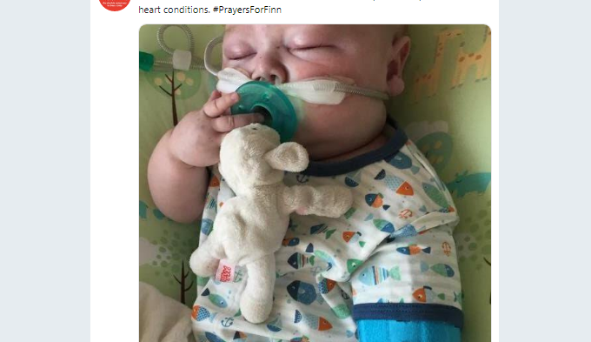
Prayers for Finn was not a marketing campaign in the traditional sense. Magnetic Me donated 50 union suits (short-sleeved, footless onesies) to babies with heart conditions magnetic closures make it much easier to dress babies who undergo frequent surgery and are hooked up to intravenous tubes. While we did not seek to benefit commercially from doing this, we did want people to know about it. I emailed with Finn’s mother throughout the donation process, and she was very happy to use Finn’s image to spread awareness.
We #donated 50 union suits to the UVA Children’s Hospital to help babies with heart conditions. #PrayersForFinn

Slide 35
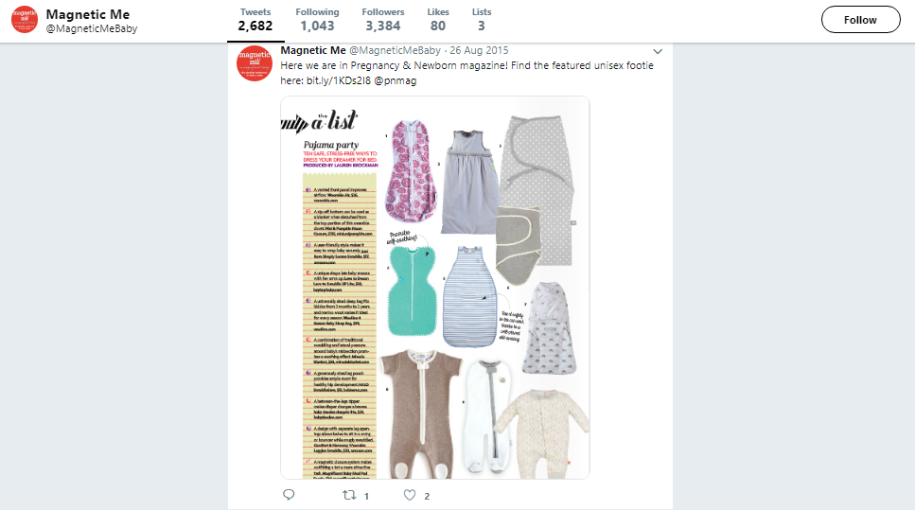
Here we are in Pregnancy & Newborn magazine! Find the featured unisex footie here:

Slide 36
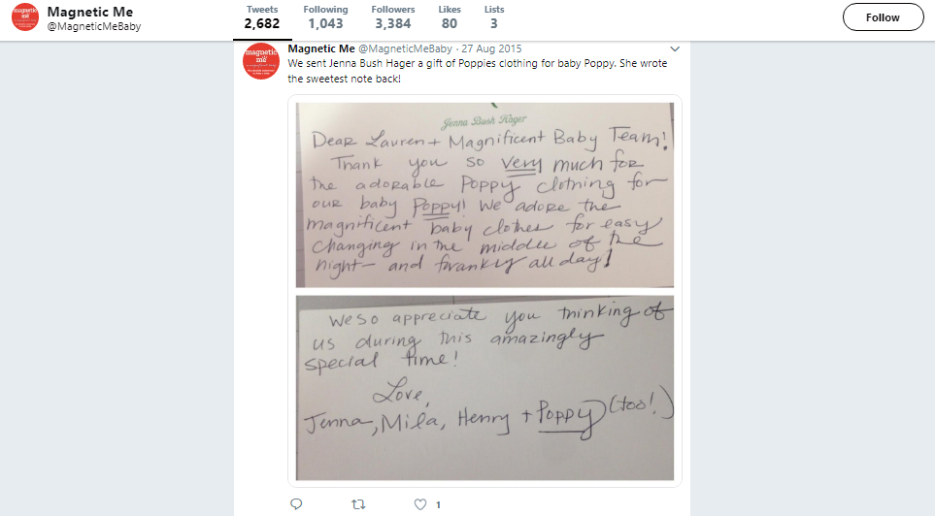
Note: “Dear Lauren + Magnificent Baby Team! Thank you so very much for the adorable Poppy clothing for our baby Poppy! We adore the magnificent baby clothes for easy changing in the middle of the night – and frankly all day! We so appreciate you thinking of us during this amazingly special time! Love, Jenna, Mila, Henry + Poppy (too!)”
We sent Jenna Bush Hager a gift of Poppies clothing for baby Poppy. She wrote the sweetest note back!

Slide 37
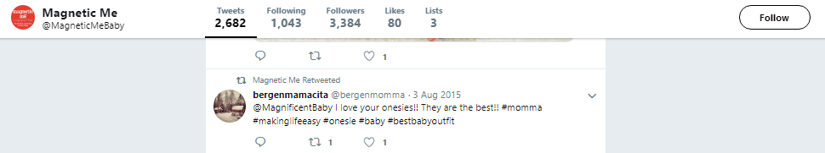
[Retweet] @MagnficentBaby I love your onesies!! They are the best!!! #moma #makinglifeeasy #onesie #baby #bestbabyoutfit

Slide 38
Lights, rattles, action! #photoshoot
One of many live tweets from our Spring 2016 photo shoot.

Slide 39
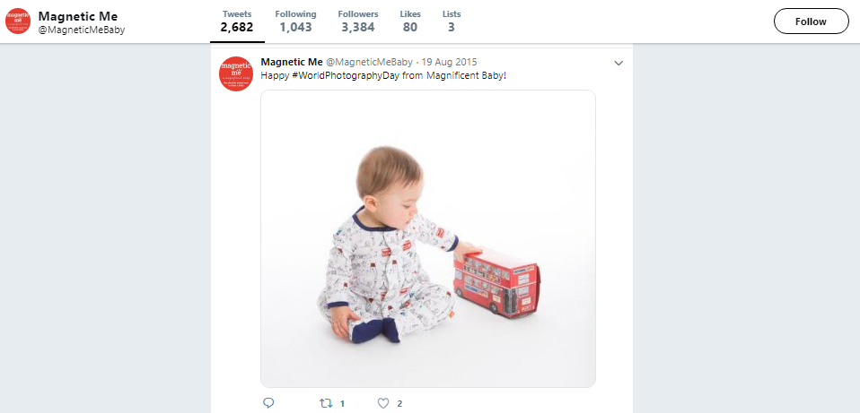
Trending hashtag; our Tally Ho on the Go footie
Happy #WorldPhotographyDay from #MagnificentBaby!

Slide 40
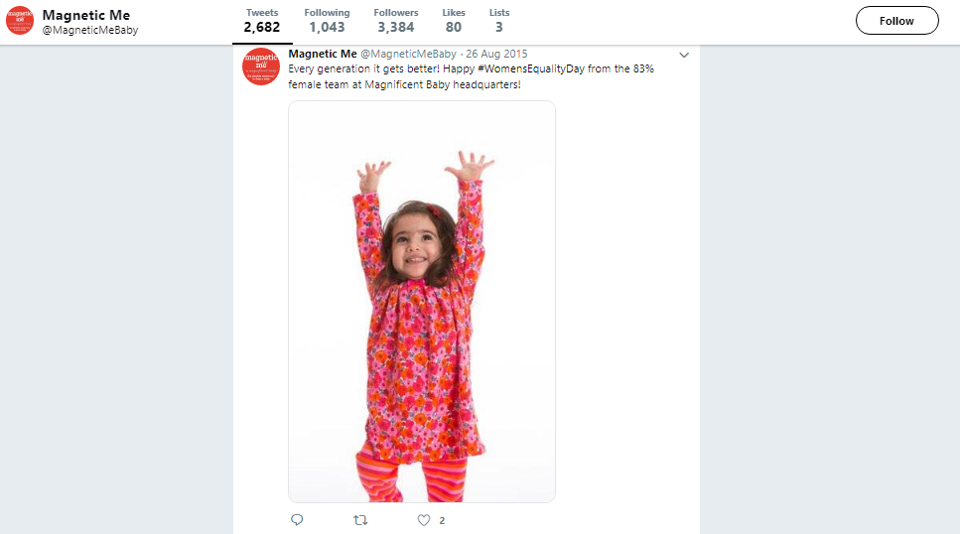
Trending hashtag; our Poppies dress set
Every generation it gets better! Happy #WomensEqualityDay from the 83% female team at Magnificent Baby headquarters!

Slide 41
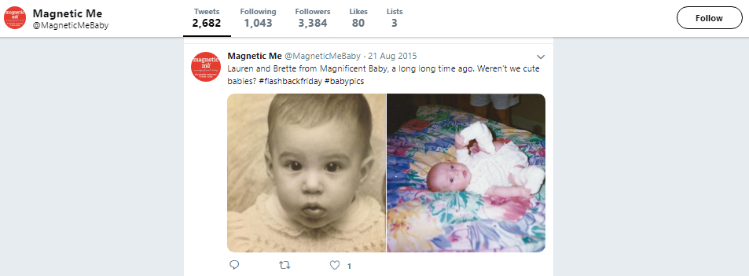
Trending hashtag; the founder (left) and me!
Lauren and Brette from Magnificent Baby, a long long time ago. Weren’t we cute babies# #flashbackfriday #babypics

Slide 42
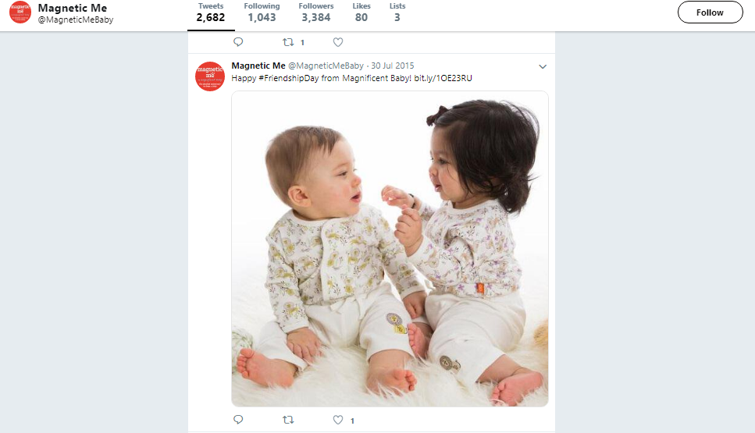
Trending hashtag; our The Lion and the Mouse top sets.
Happy #FriendshipDay from Magnificent Baby!

Slide 43
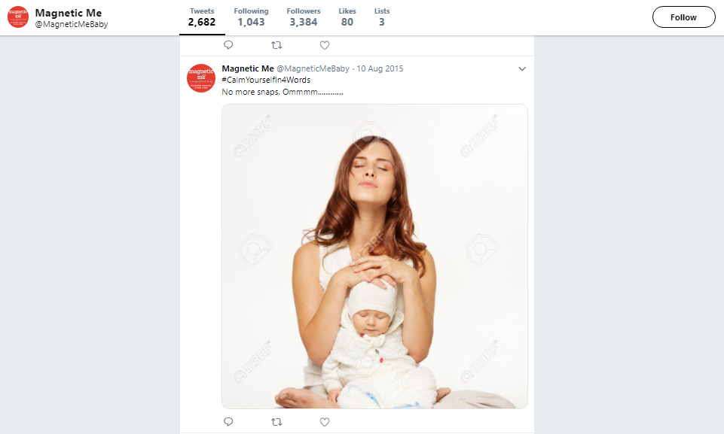
Trending hashtag
#CalmYourselfin4Words No more snaps. Ommmm……

Slide 44
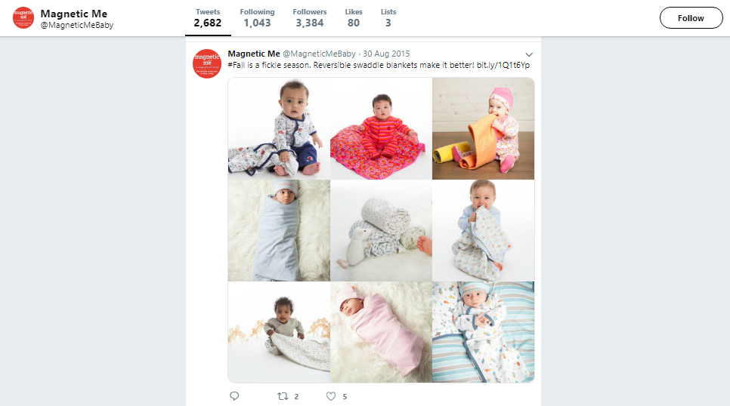
The website back end kept track of inventory levels for each SKU. Swaddle blankets were an underperforming category with more unsold inventory. I made a point of tailoring posts around these products (without, of course, revealing why). This strategy moved units; by cross-referencing Facebook Insights and Google Analytics data, I found that our 20 best-selling products were 5.3 times more likely to have appeared in a post than our 20 worst-selling products.
#Fall is a fickle season. Reversible swaddle blankets make it better!

Slide 45
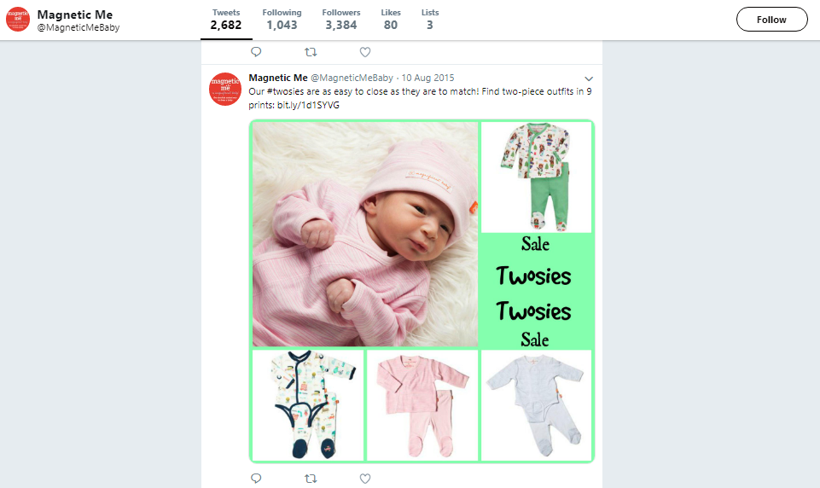
The website back end kept track of inventory levels for each SKU. While our seasonal collections were going strong, Magnetic Me faced an issue of older products, launched when they were lesser-known, taking up a significant share of space on the website and in the warehouse, in broken size runs that were difficult to sell to our accounts. I made a point of tailoring posts around these products (without, of course, revealing why). This strategy moved units; by cross-referencing Facebook Insights and Google Analytics data, I found that our 20 best-selling products were 5.3 times more likely to have appeared in a post than our 20 worst-selling products.
Our #twosies are as easy to close as they are to match! Find two-piece outfits in 9 prints:

Slide 46
Pinterest
I created four new boards referencing Magnetic Me’s innovative use of magnets for baby clothing and baby topics in general, with aesthetic and humor appeals.

Slide 47
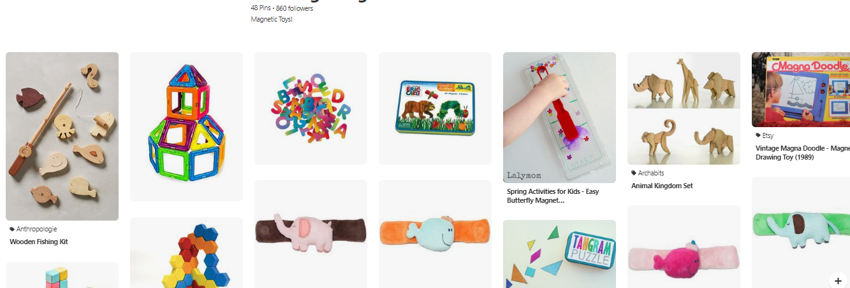

Slide 48
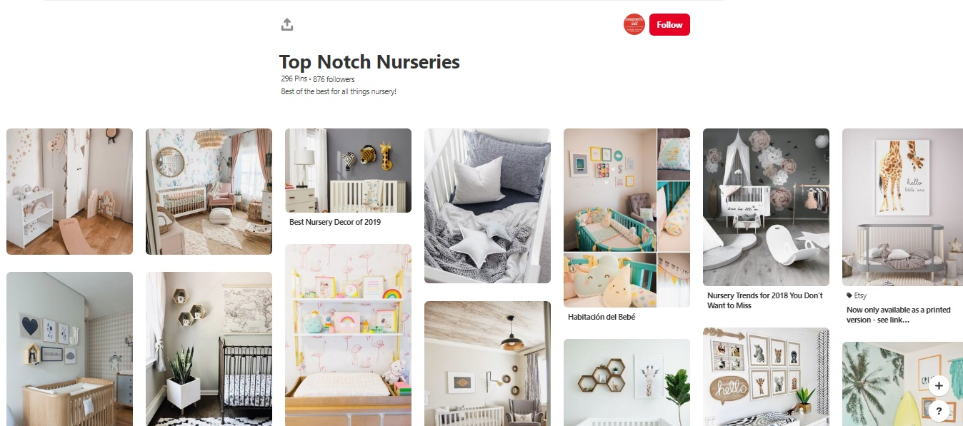

Slide 49
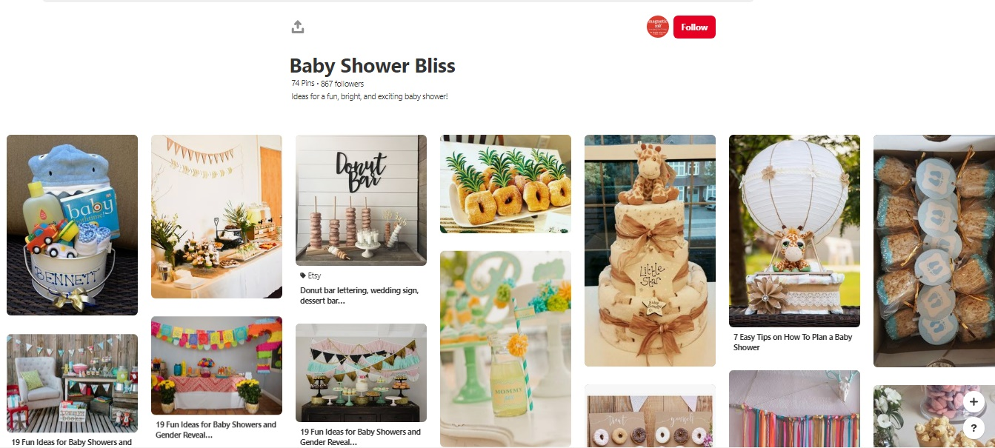

Slide 50
