Slide 1
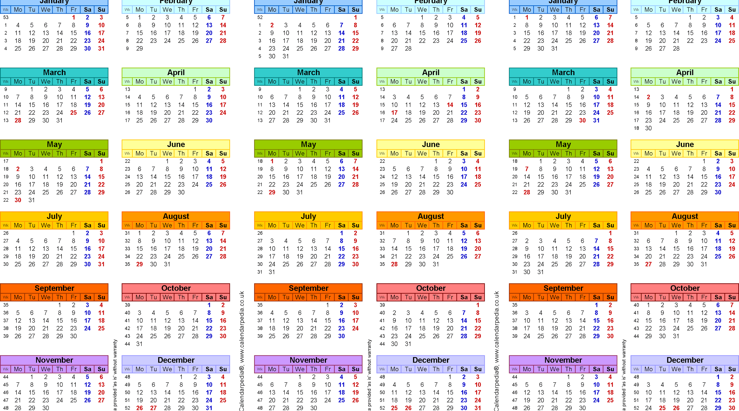
Transitions in the Fashion Industry Experimenting with a new calendar
Executive Practitioner Seminar: Dynamics of the Fashion Industry
Professor Carr
Brette Connolly, Maya Jesselson, Khalei McKown & Dorren Rosenbaum

Slide 2

Changes in Consumer Behavior

Slide 3
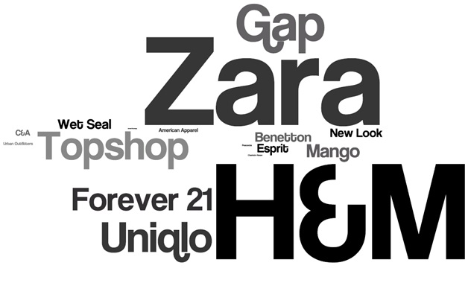
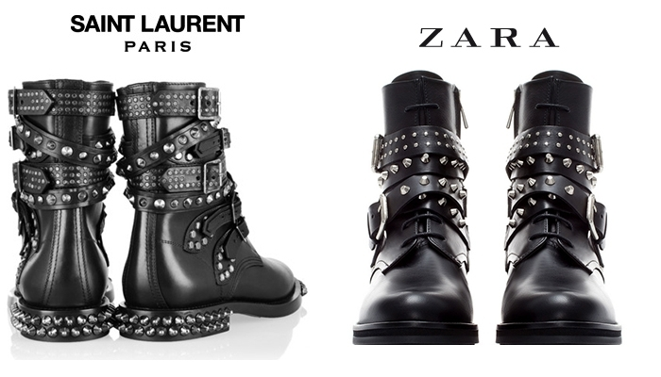
Fast Fashion Affecting High Fashion
Knocking off high end designers
Faster Production
Does a good job at inviting the consumer back into their store because the store is constantly updating their merchandise

Slide 4
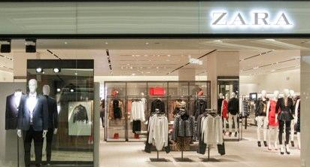
Zara: Desire for New Product
Freshness of its offerings
Quick turn around results in scarcity for the item
New designs twice-weekly shipment.
“About three-quarters of the merchandise on display was changed every three to four weeks, which also corresponded to the average time between visits given estimates that the average. Zara shopper visited the chain 17 times a year, compared with an average figure of three to four times a year for competing chains and their customers.” [Harvard Business School Review Zara: Fast Fashion]

Slide 5

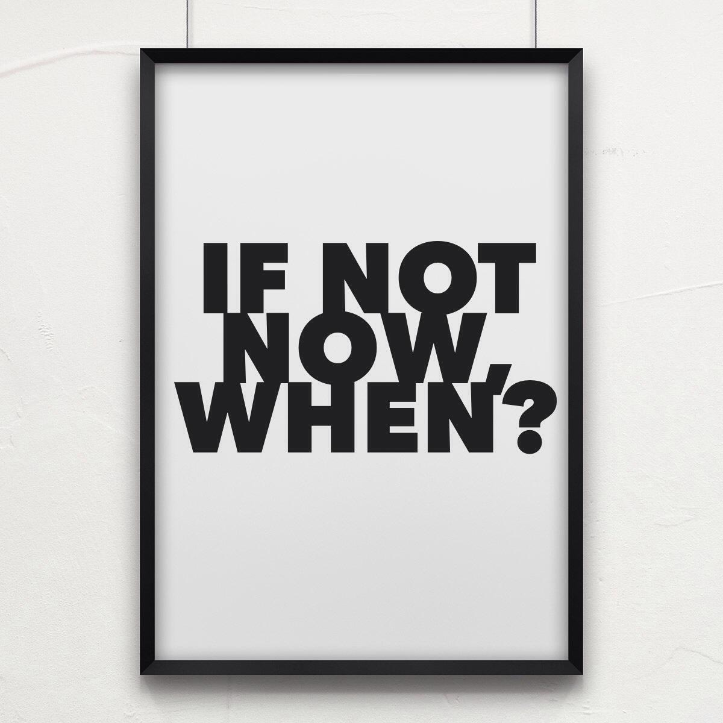
Social media gives us the ability to instantaneously stream, capture, and share images from runway shows
Consumers know the collection the moment it is shown
When the collections hits stores- it’s old news

Slide 6
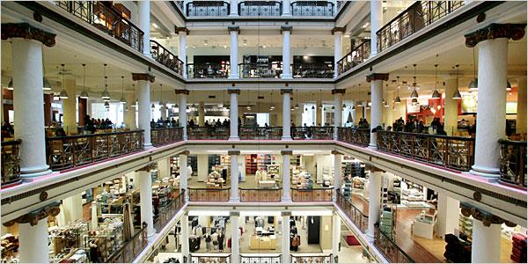
RETAILERS
Retailers want to have newness to their stores while designers have to produce more for them to do this and it hurts their business because it will be more likely to be marked down the faster cycle means faster markdowns

Slide 7

See Now Buy Now Challenges
Brands and stores would not be able to use the social media reaction to runway items to inform their buying decisions. With see-now-buy-now, the consumers would not be able to comment on anything until it was already in stores
Some fear that runway shows become more commercial and less creative because the designers know that consumers are going to be shopping the collections straightaway

Slide 8
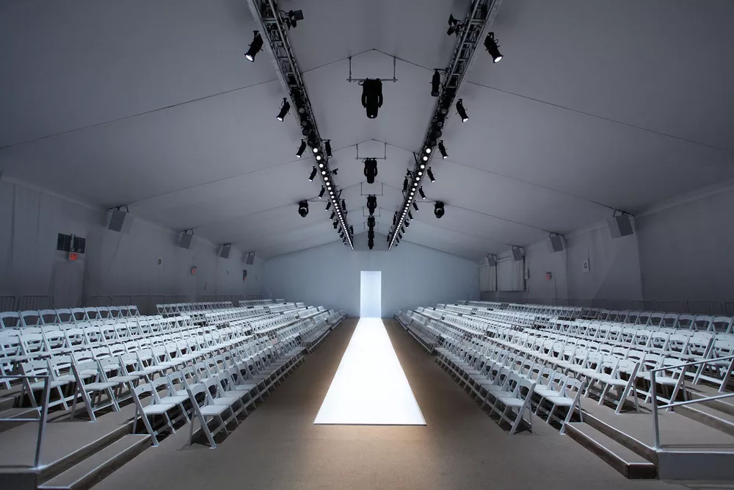

The CFDA Case Study: Examining the Future Of NYFW
(clears up a lot of misconceptions, especially regarding manufacturing)
Designers will NOT need to manufacture in advance
Orders still placed 4-6 months before stores deliveries
It will not compress current manufacturing time or the quality
Designers will optimize timing on showing images of their collection at the best time to optimize their impact/ opportunities
We will see at NYFW “consumer- relevant” events that are targeted to the industry participants. The events will be shown at the appropriate time for the brand. This will allow for more of a storytelling experience and intimate presentation; while reinstating the focus on the product in the hopes of reducing consumer fatigue and exciting them

Slide 9

Key Players - The Supporters
Has Shown Privately
  Balenciaga, Proenza Schouler, The Row (Pre-Fall); Burberry, Madewell, Proenza Schouler, Rebecca Minkoff, Thakoon, The Row, Tom Ford, Tommy Hilfiger (Fall)
Panseasonal
  Burberry, Courrèges, Tommy Hilfiger, Paco Rabanne, Yeezy
Line Consolidation
  Paul Smith
  Burberry
Buy-Now Capsule
  Alexander Wang, Alice + Olivia, Diane von Furstenberg, Lela Rose, Michael Kors, Moschino, Paco Rabanne, Prada, Theory, Tory Burch, Balmain (considering it), Proenza Schouler (this coming fall), Tommy Hilfiger (this coming fall with Gigi Hadid) Alexander Wang (handbags), Courrèges
2 Collections, Not 4
  Cédric Charlier, Public School, Vêtements

Slide 10



“If shoppers can buy ‘real’ items immediately at full price, they might be less inclined to wait a few weeks to buy a cheaper knock-off version.” -- Áslaug Magnúsdóttir, co-founder of Moda Operandi
“Our customer doesn’t think in terms of seasons, she just thinks about what works for her life and what she’s in love with.” -- Michael Kors

Slide 11
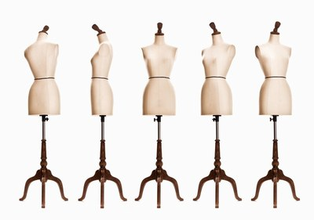
Key Players - The Traditionalists
Fédération Française de la Couture du Prêt-à-Porter des Couturiers et des Créateurs de Mode
Agnès B.
Chloé
Dior
Dries Van Noten
Hermès
Isabel Marant
Issey Miyake
Kenzo
Lanvin
Maison Margiela
Nina Ricci
Raf Simons
Rick Owens
Yves Saint Laurent
Camera Nazionale della Moda

Slide 12
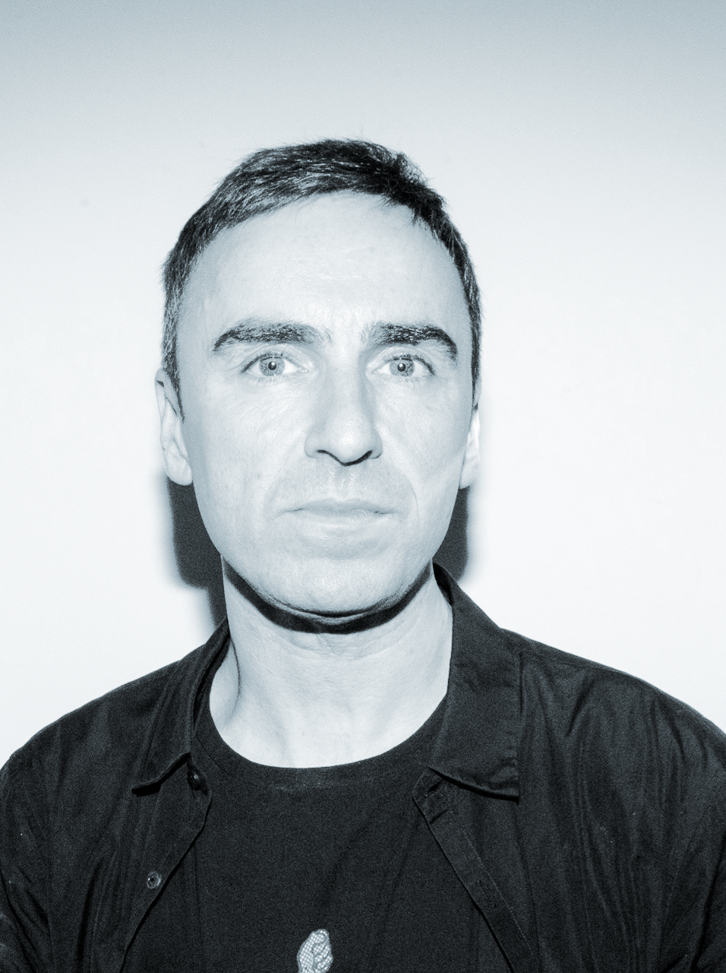

“‘Oh my God, should we sell the garments the day after the show or three days after the show or should we tweet it in this way or Instagram it in that way?’...You know, all that kind of bullshit...What we should ask is will we have enough creative people who are... willing to do what is necessary right now to follow that madhouse.” -- Raf Simons
“New York has always been the land of branding and marketing. We (Italy) and France, we are more the area of creativity and manufacturing.” -- Mario Boselli, Camera Nazionale della Moda
“I think this is a fast-fashion thing...I don’t know if we need to compete with that. Maybe we need to become even slower and less available...I don’t know if I want stuff to be accessible right away, because then that makes it just too disposable.” -- Rick Owens
“The difference between creating a desire and satisfying a need is the difference between slow fashion and fast fashion.” -- Carlo Capasa, president of the Camera Nazionale della Moda

Slide 13

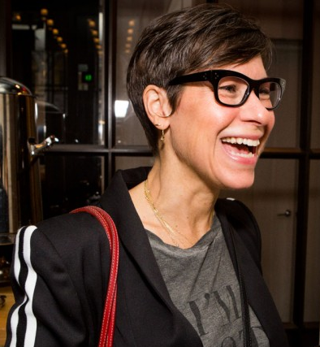

Relatable Class Speakers Comments
Lisa Metcalfe
“Fashion Week always has been about marketing
Designers don’t expect to sell all of the styles they show. A runway show can strap a brand of so much cash and time. You need the press to review your line, and some press demand a show. Pam & Gela doesn’t do Fashion Week, they do a lookbook. Tracy Reese opted out of Fashion Week, did a video instead.
Fashion calendar shift only works for brands with a lot of money.Put it on the floor when people want to buy it, then it won’t get marked down” (i.e. wait until it’s warm to put out swimwear, wait until it’s cold to put out coats). CFDA: Boston Consulting Group can’t only interview the big designers (Tory Burch, Diane von Furstenberg, etc.) if they want to understand the overall picture.”
Marc Karimzadeh
“How could we look at fashion not in the traditional way? The consumer is changing and what is their needs and how do they look at fashion?”“Fashion is a business that is so into the trends but it does not evolve into considering the future. It is outdated”

Slide 14

Predictions & recommendations
More division between New York and London brands/presentations versus Milan and Paris
The answer isn’t to produce more quickly, but to produce at a standard schedule & holding off on showing the images until the clothes are available or are about to be available in stores
We think this will keep the consumers engaged
More of an issue for less-established brands (they will have inventory but won’t know know units)

Slide 15
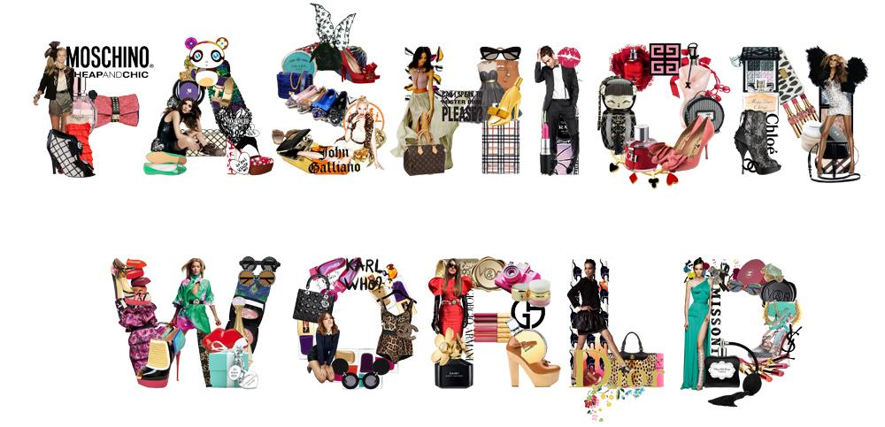
Thank You!

